Slide 1
Github Project : https://github.com/daffasutrisno/Project-Forecast.git
Program: forecast_01_main_total.py → visualize_01_all_forecasts.py
Output: forecast_results/01_main/03_traffic_forecast_lengkap.png

Slide 2
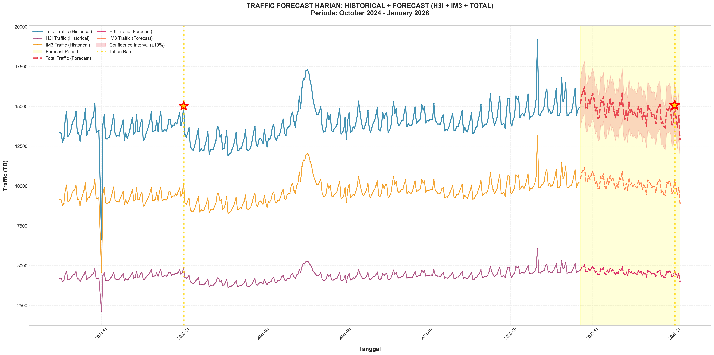
Traffic Forecast Lengkap: Historical + Forecast

Slide 3
Github Project : https://github.com/daffasutrisno/Project-Forecast.git
Program: forecast_01_main_total.py → visualize_02_main_overview.py
Output: forecast_results/01_main/00_main_forecast_overview.png

Slide 4
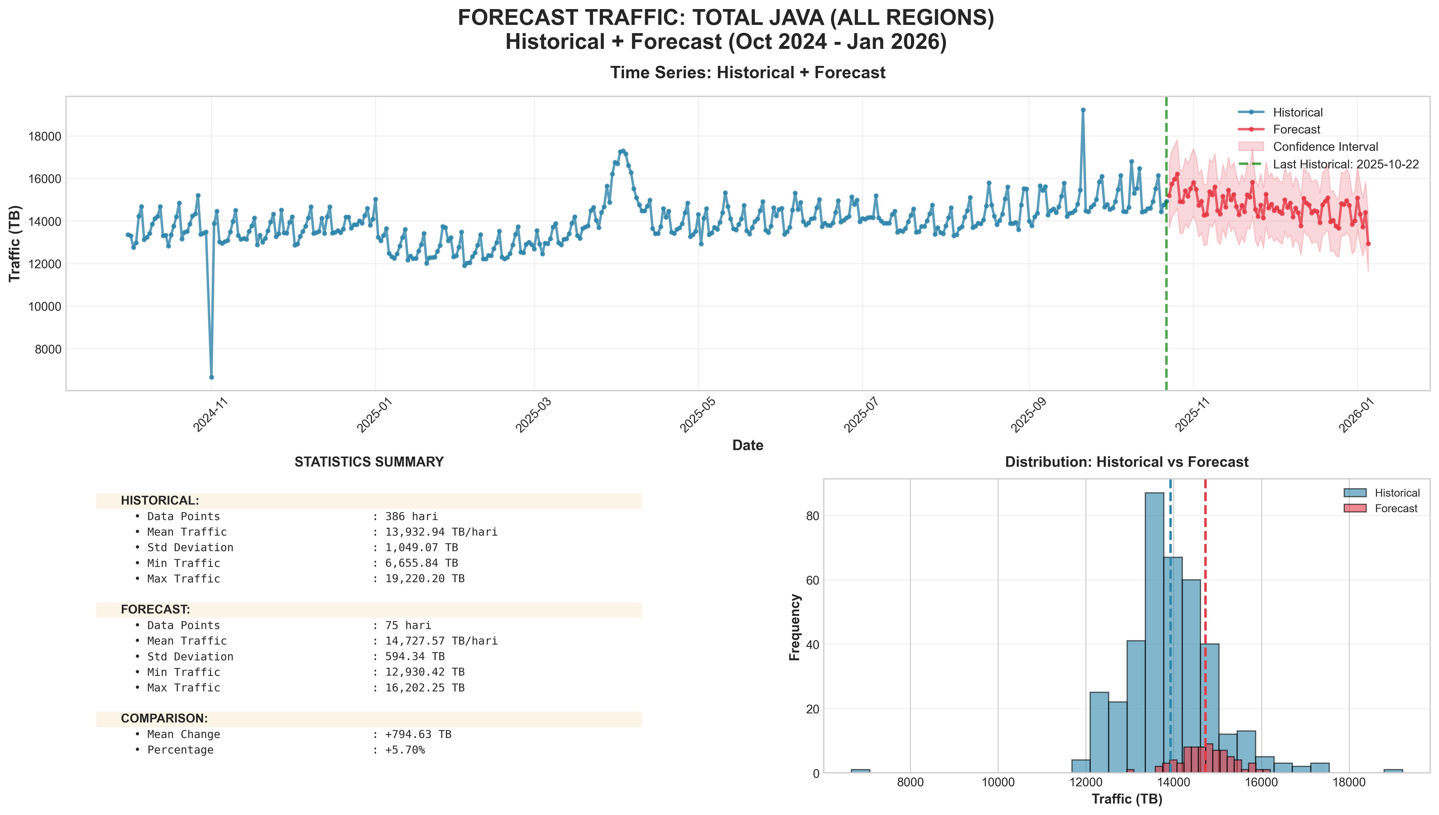
Main Forecast Overview: Total Java

Slide 5
Github Project : https://github.com/daffasutrisno/Project-Forecast.git
Program: forecast_03_by_regional.py
Output: forecast_results/02_regional

Slide 6
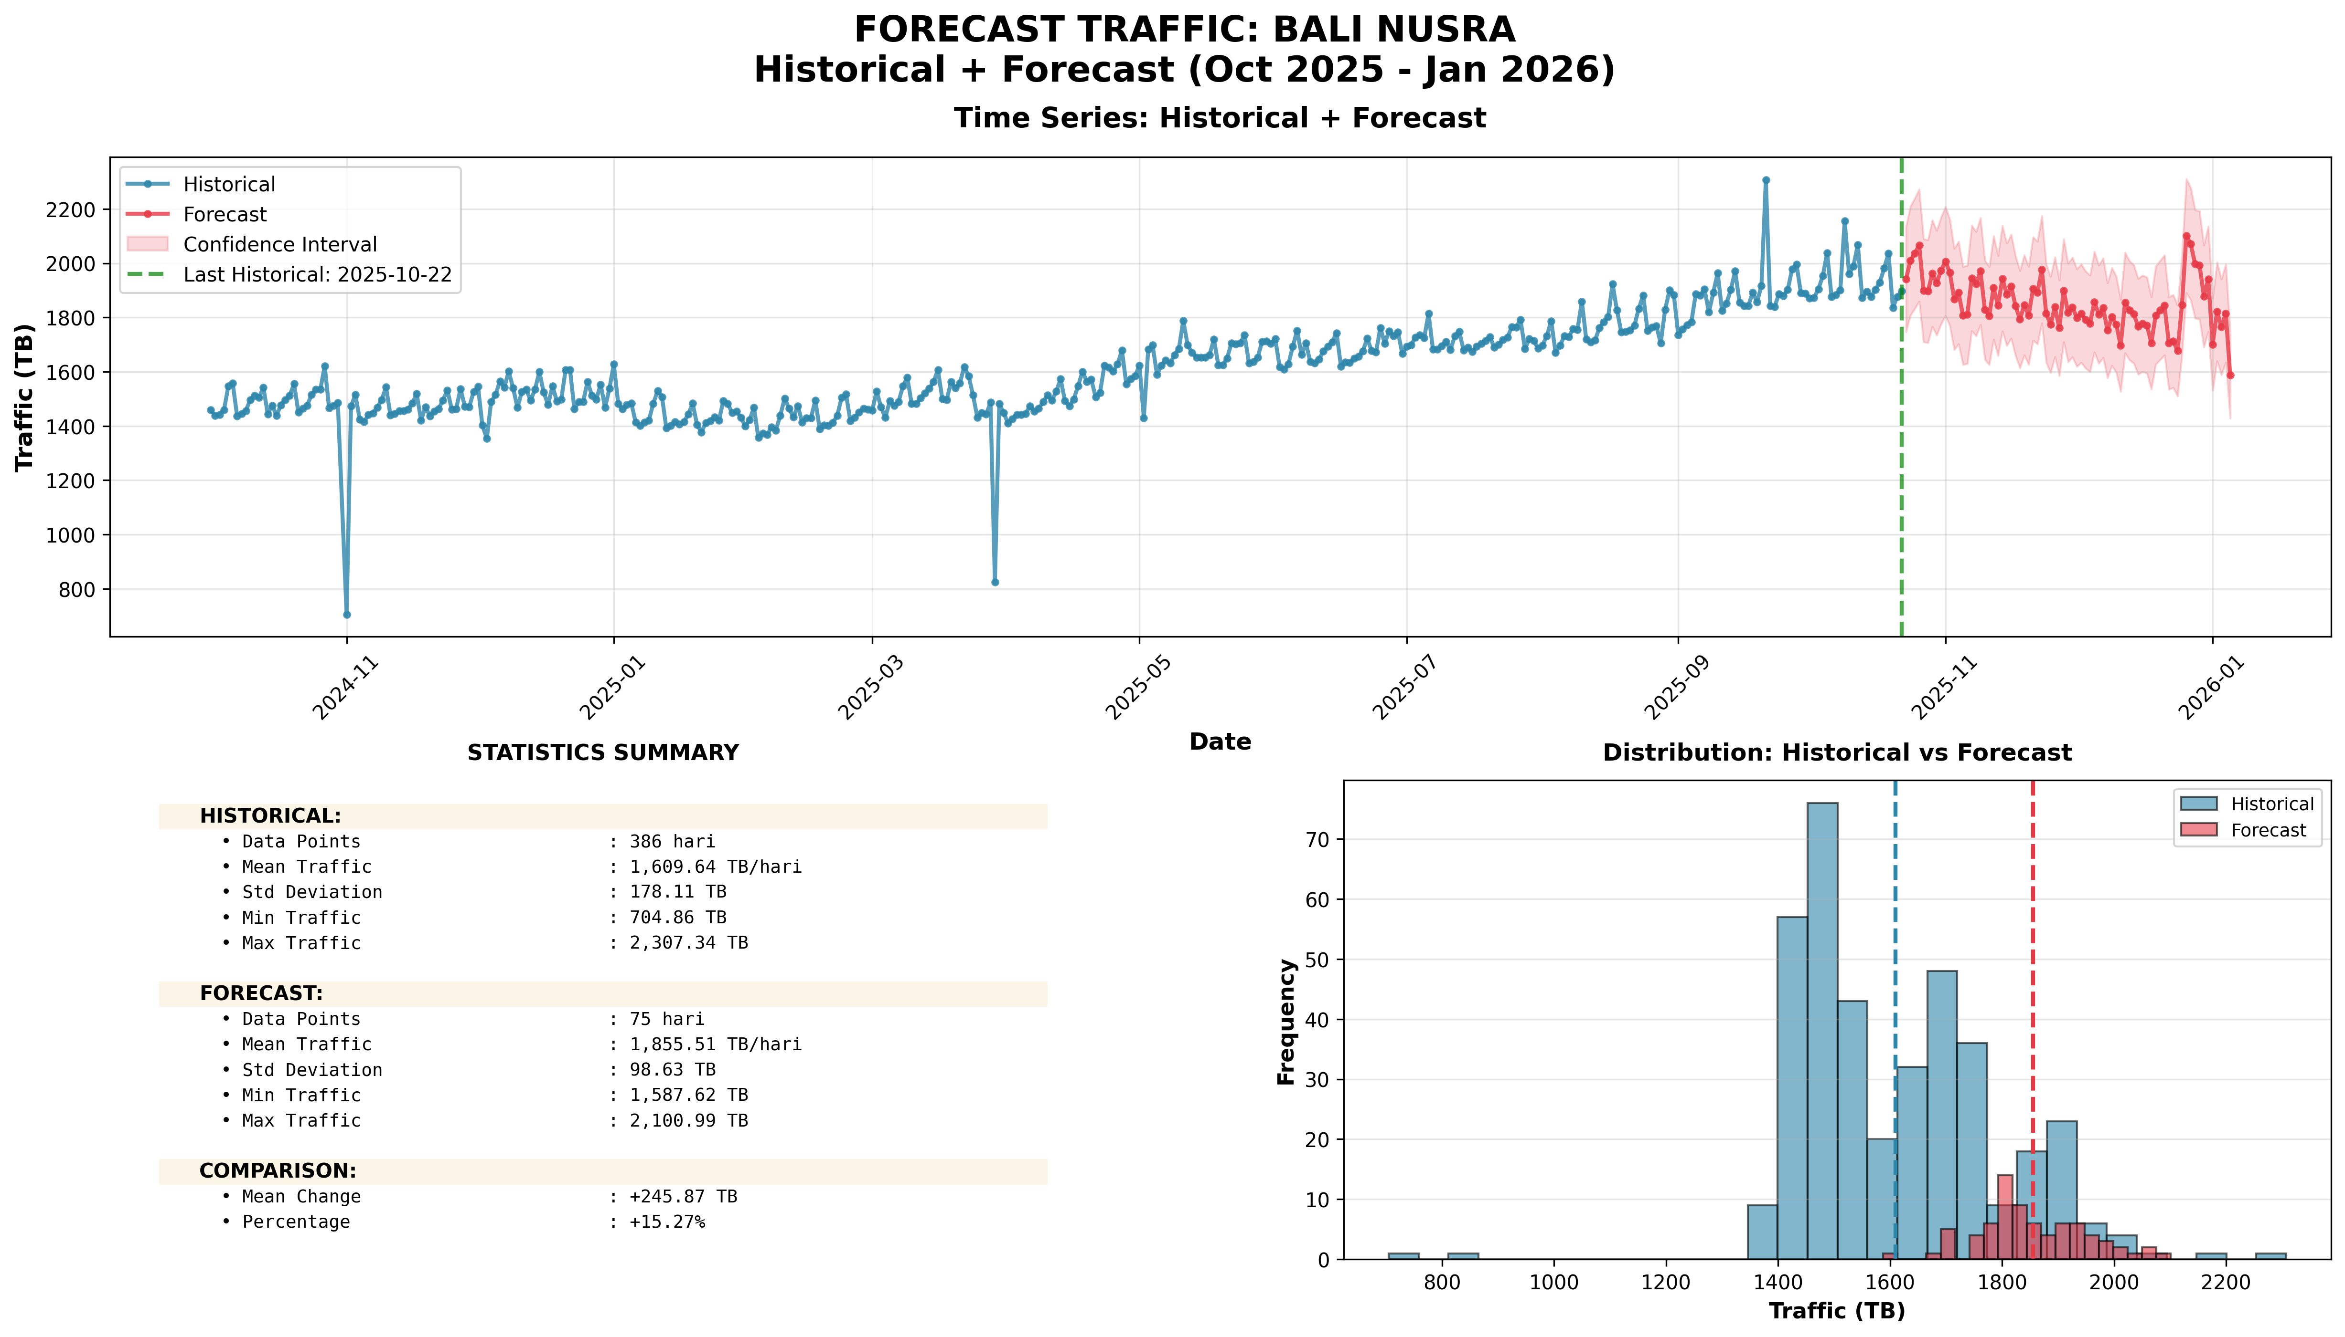
Forecast Regional: Bali Nusra

Slide 7
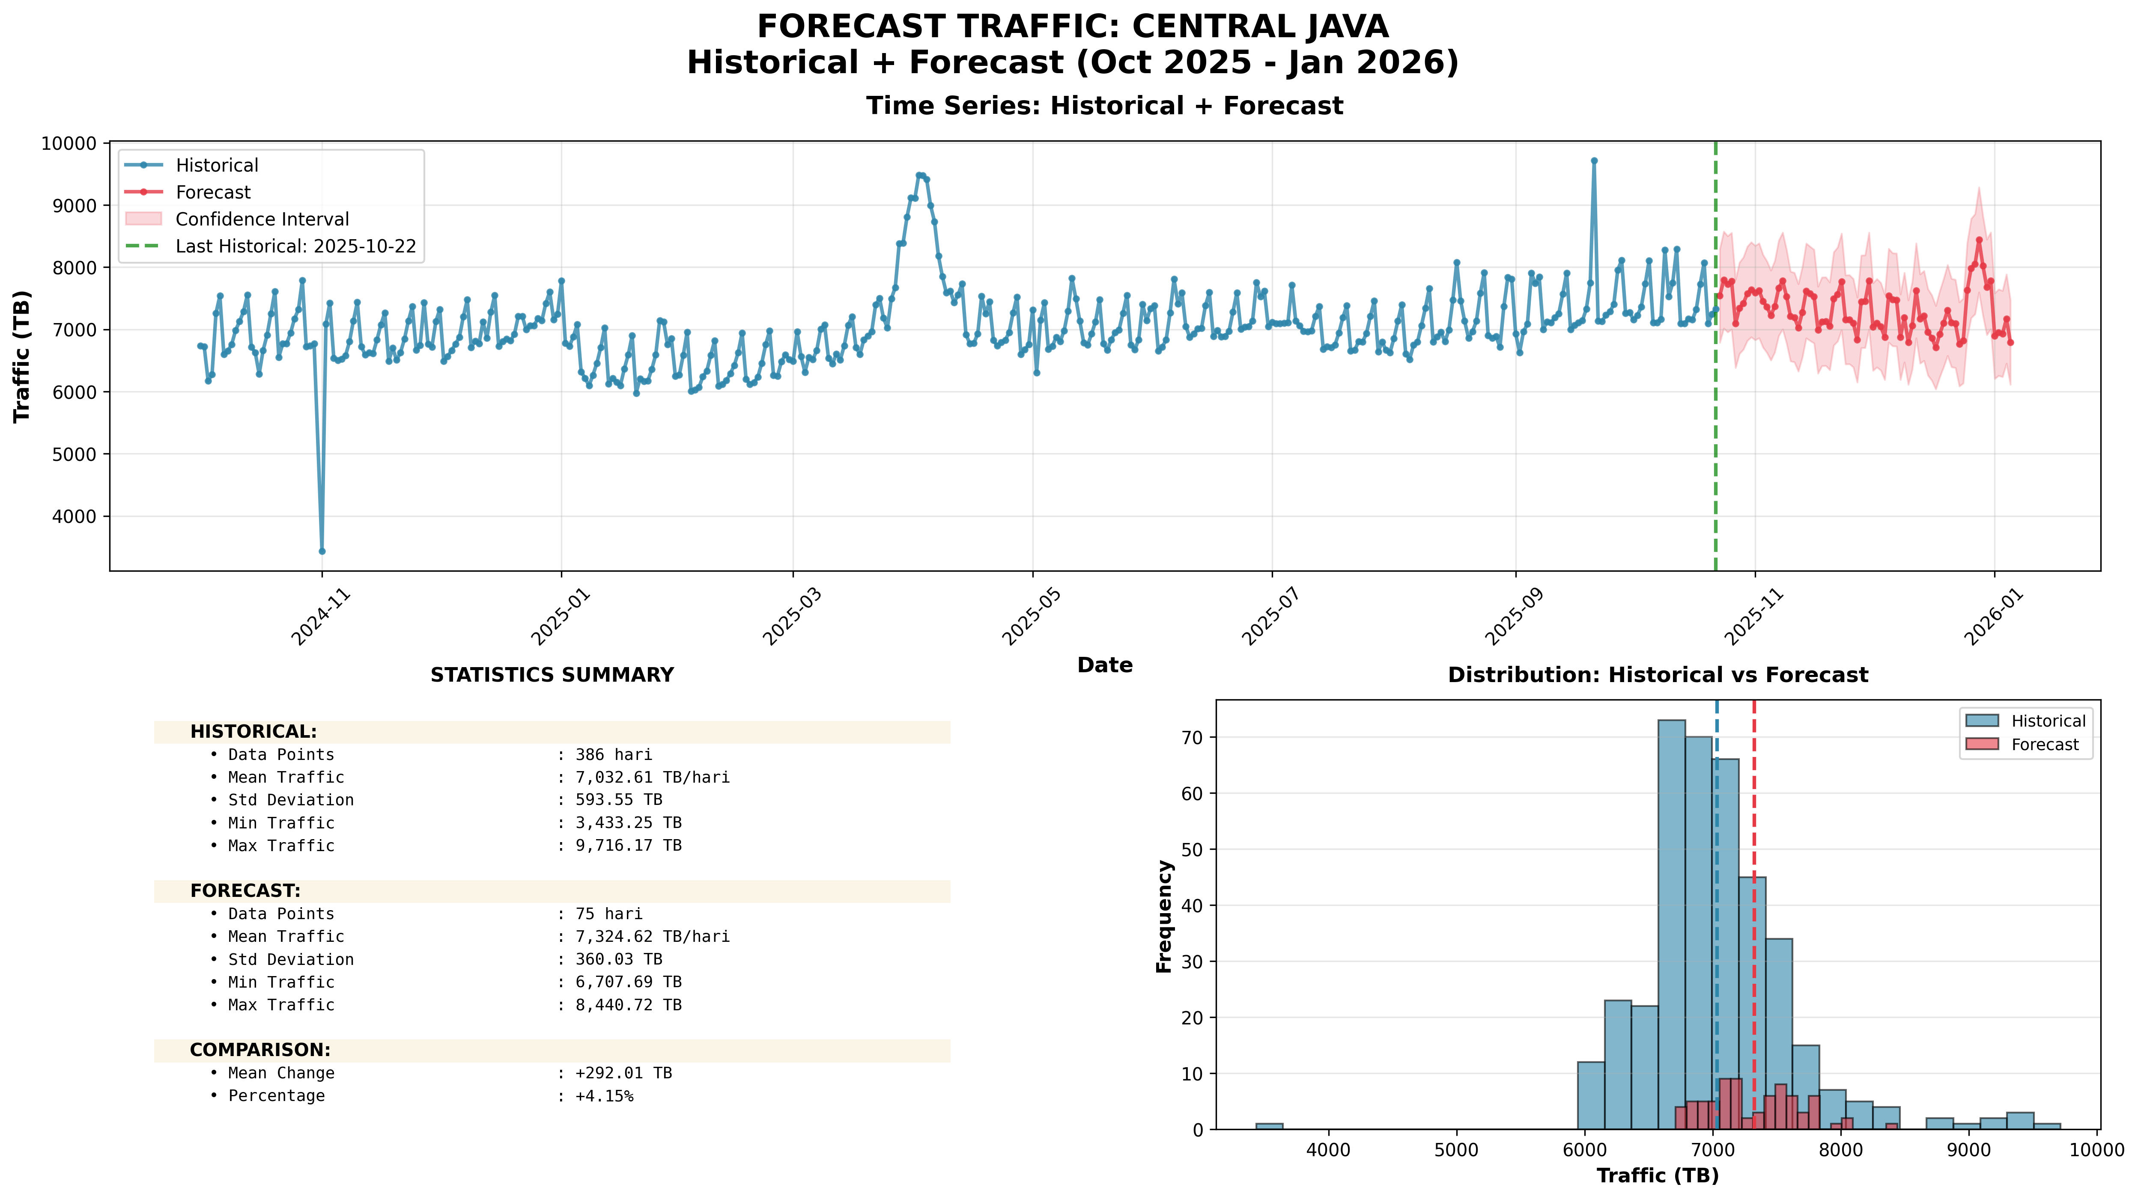
Forecast Regional: Central Java

Slide 8
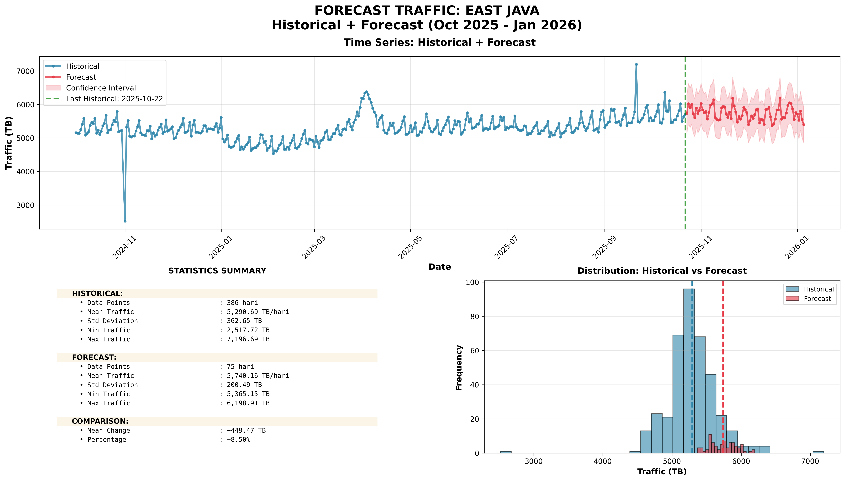
Forecast Regional: East Java

Slide 9
Github Project : https://github.com/daffasutrisno/Project-Forecast.git
Program: forecast_02_by_province.py
Output: forecast_results/03_provinsi

Slide 10
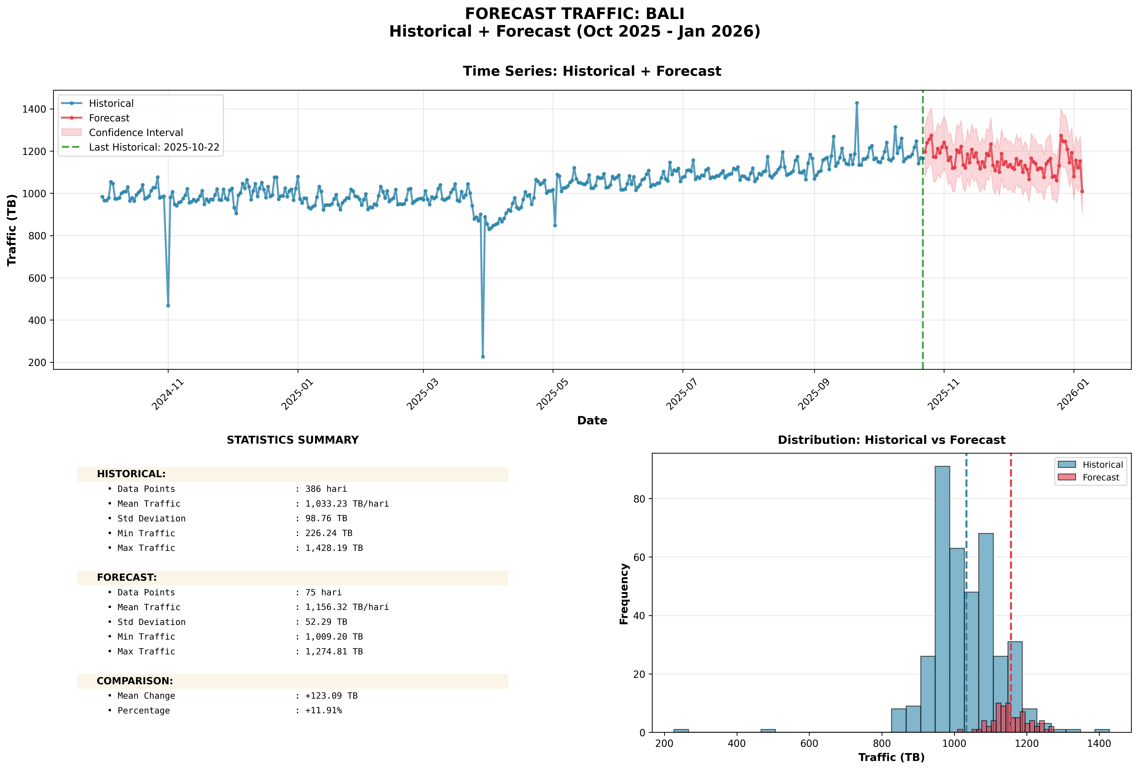
Forecast Provinsi: Bali

Slide 11
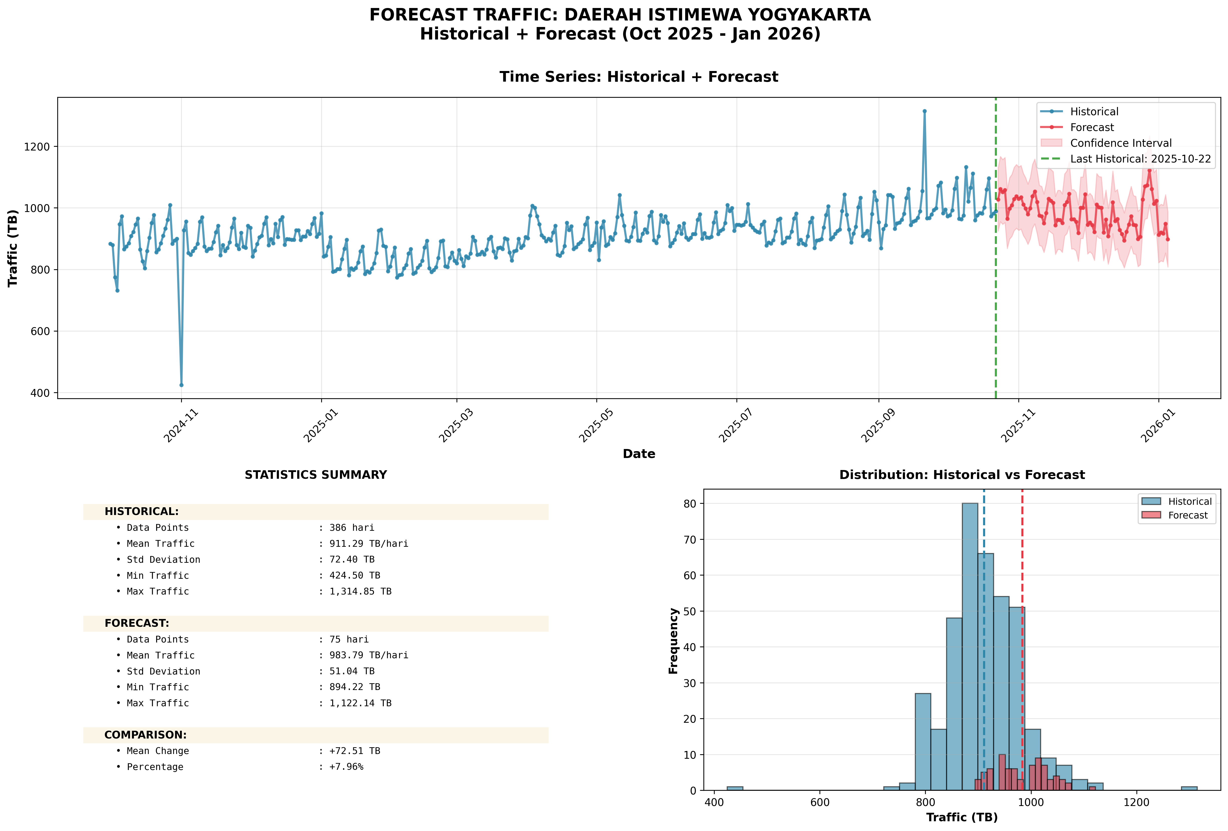
Forecast Provinsi: Daerah Istimewa Yogyakarta

Slide 12
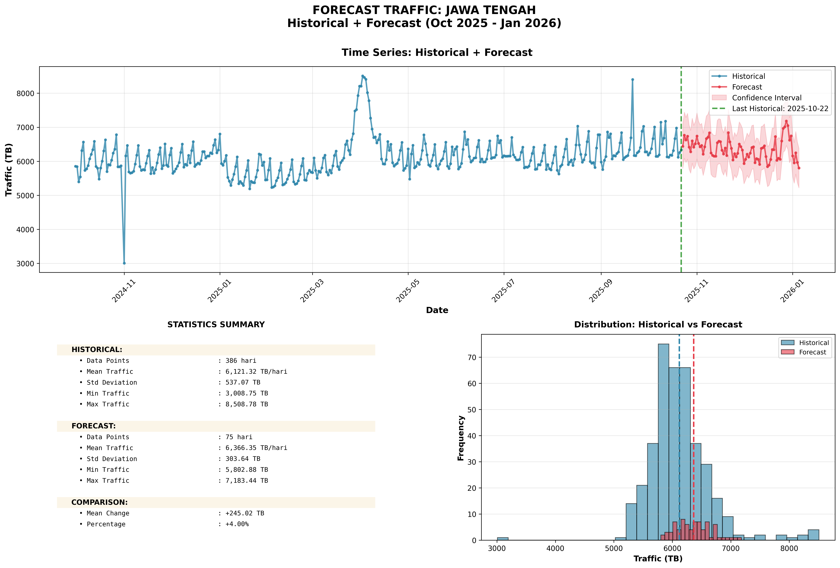
Forecast Provinsi: Jawa Tengah

Slide 13
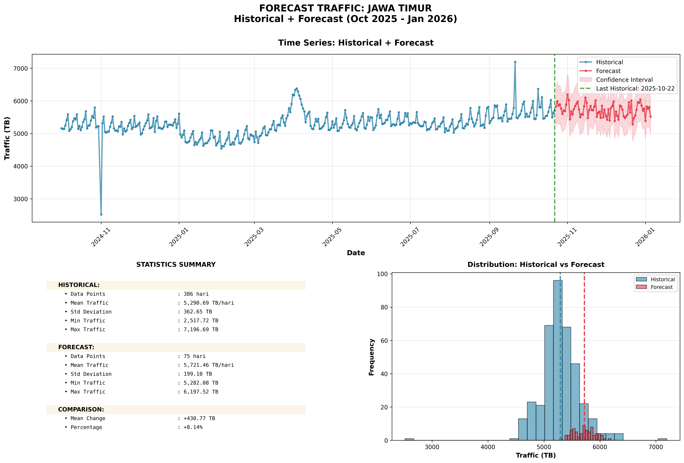
Forecast Provinsi: Jawa Timur

Slide 14
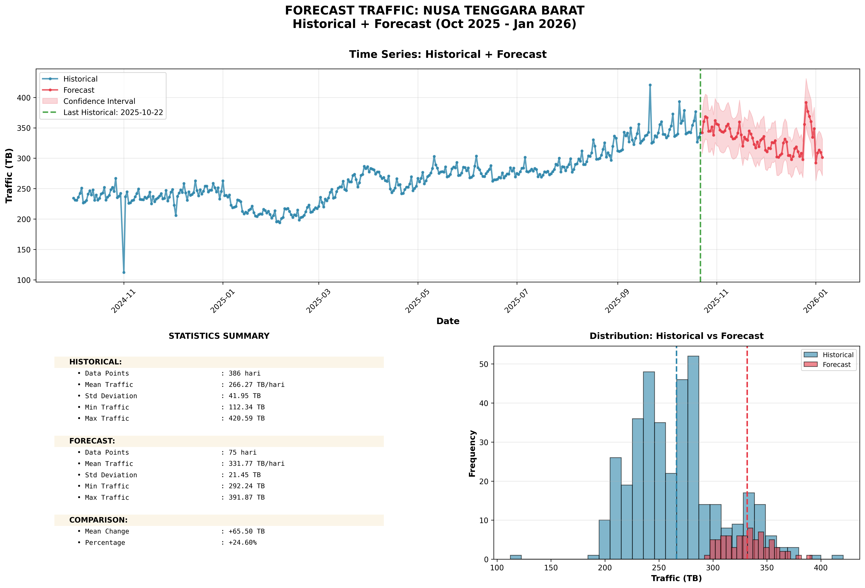
Forecast Provinsi: Nusa Tenggara Barat

Slide 15
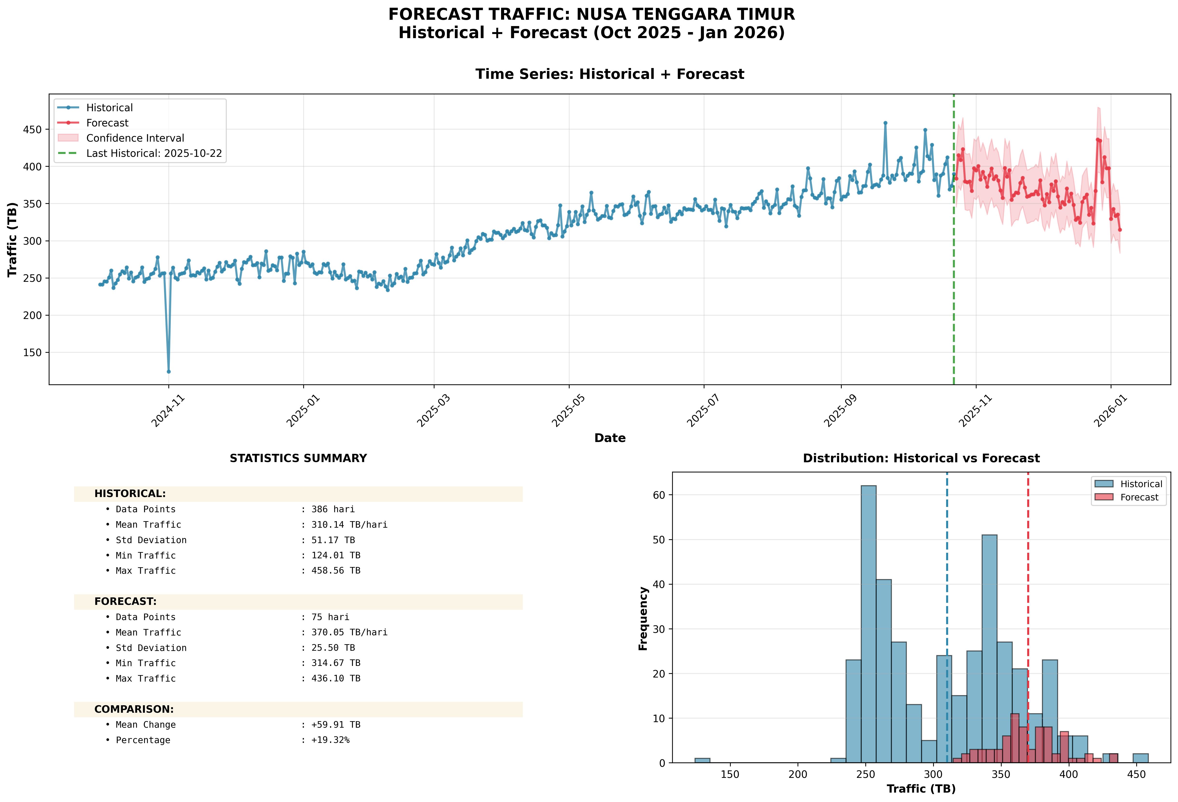
Forecast Provinsi: Nusa Tenggara Timur

Slide 16
Github Project : https://github.com/daffasutrisno/Project-Forecast.git
Program: forecast_04_by_kabupaten.py → analysis_01_top10_absolute.py
Output:
forecast_results/05_analysis/top10_kabupaten_by_absolute_change.png
forecast_results/04_kabupaten/[kabupaten]_forecast.png (10 kabupaten)

Slide 17
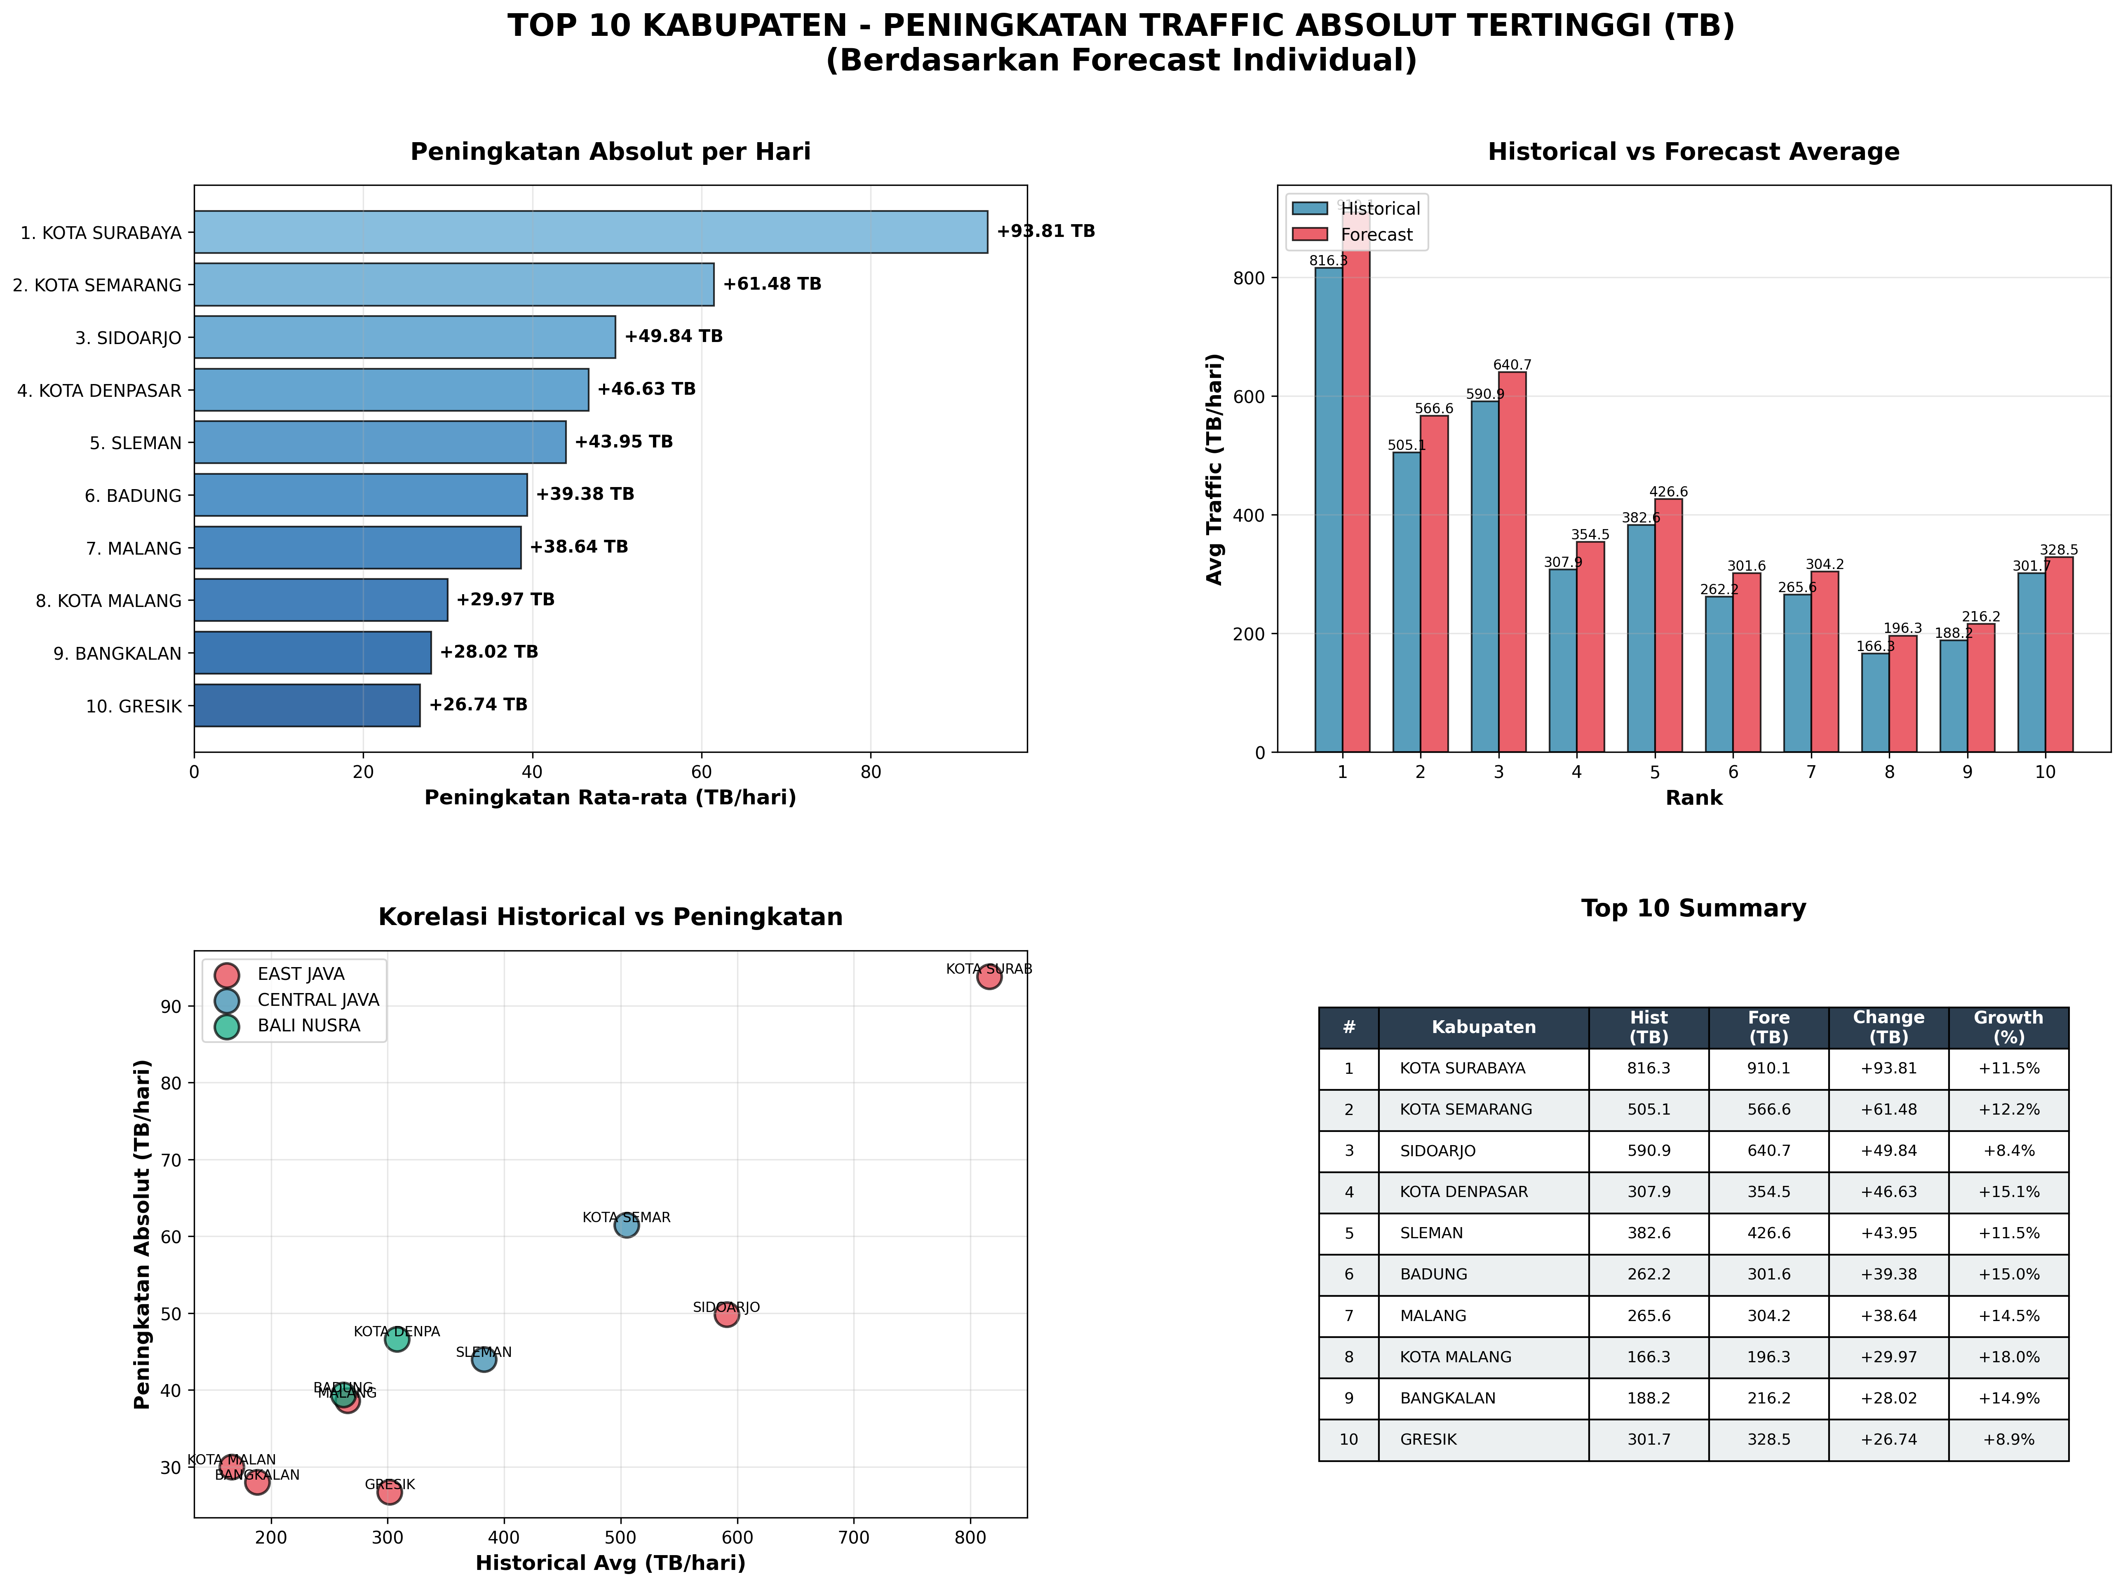
Top 10 Kabupaten: Peningkatan Absolut (TB)

Slide 18
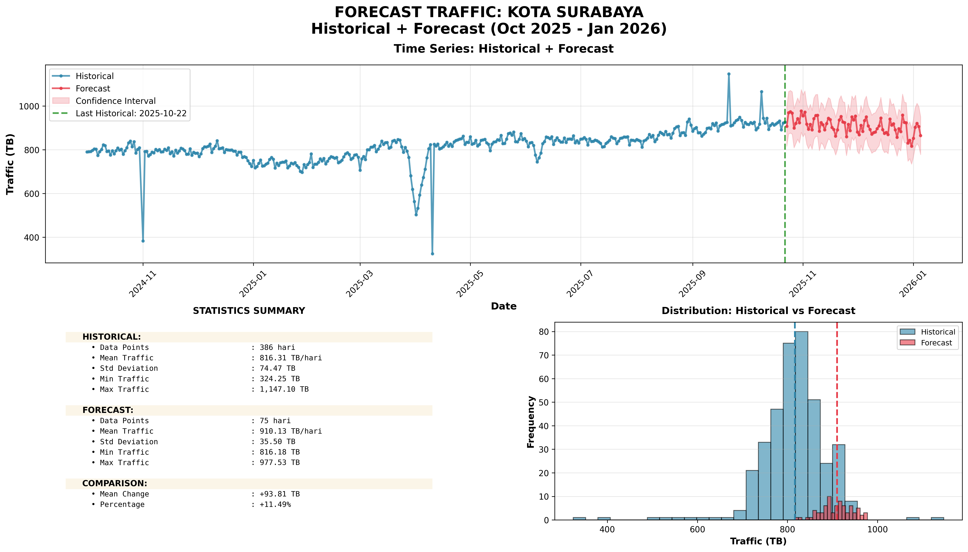
Top 10 Absolute: #1: KOTA SURABAYA (EAST JAVA)

Slide 19
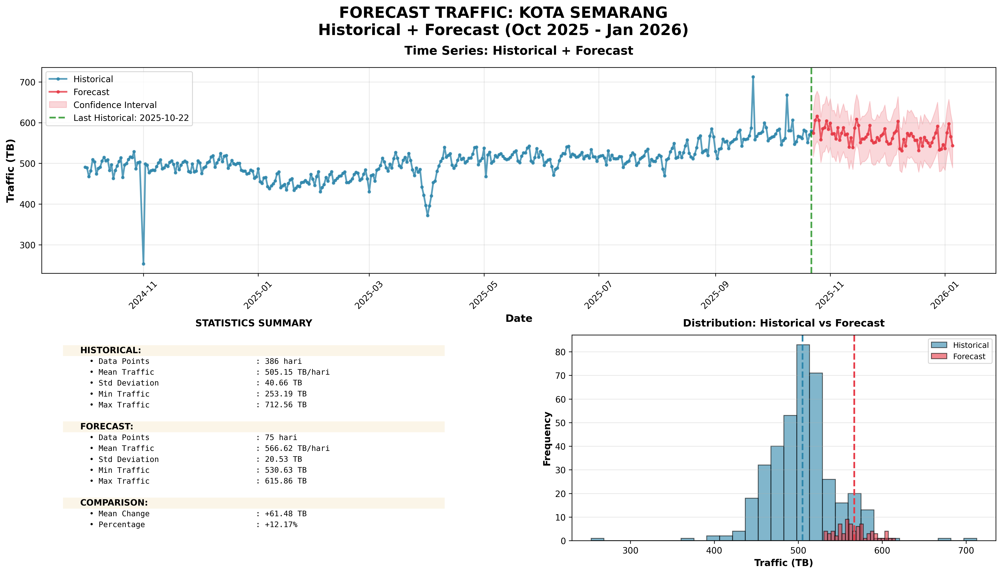
Top 10 Absolute: #2: KOTA SEMARANG (CENTRAL JAVA)

Slide 20
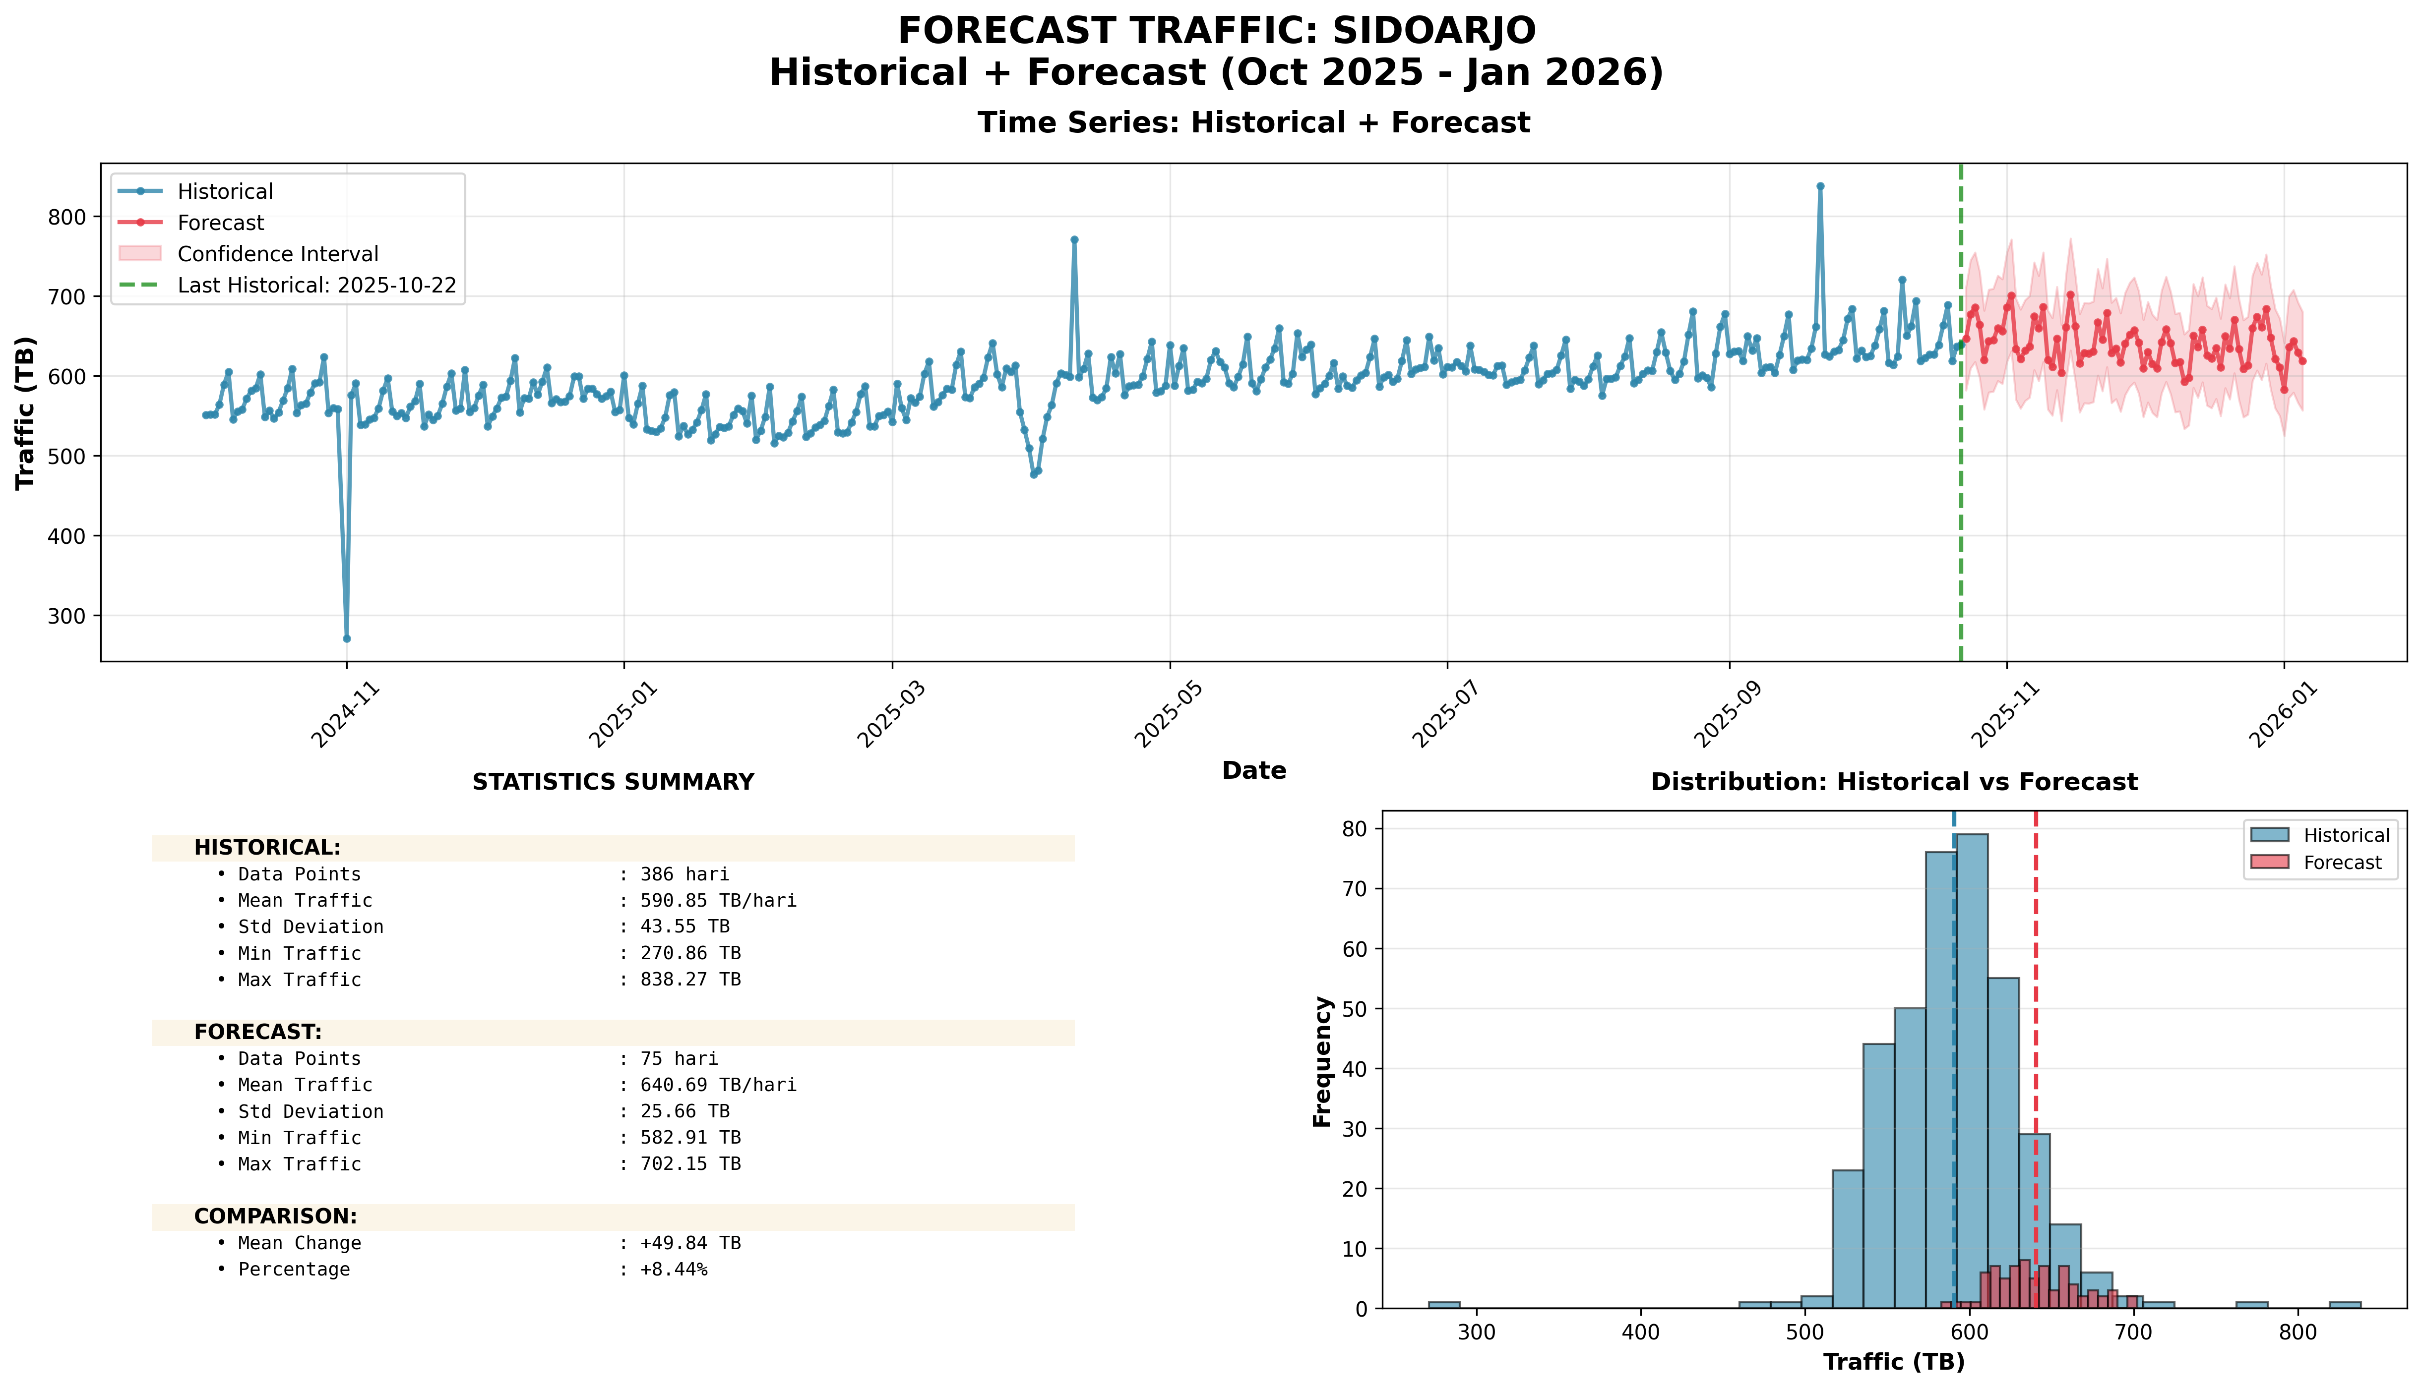
Top 10 Absolute: #3: SIDOARJO (EAST JAVA)

Slide 21
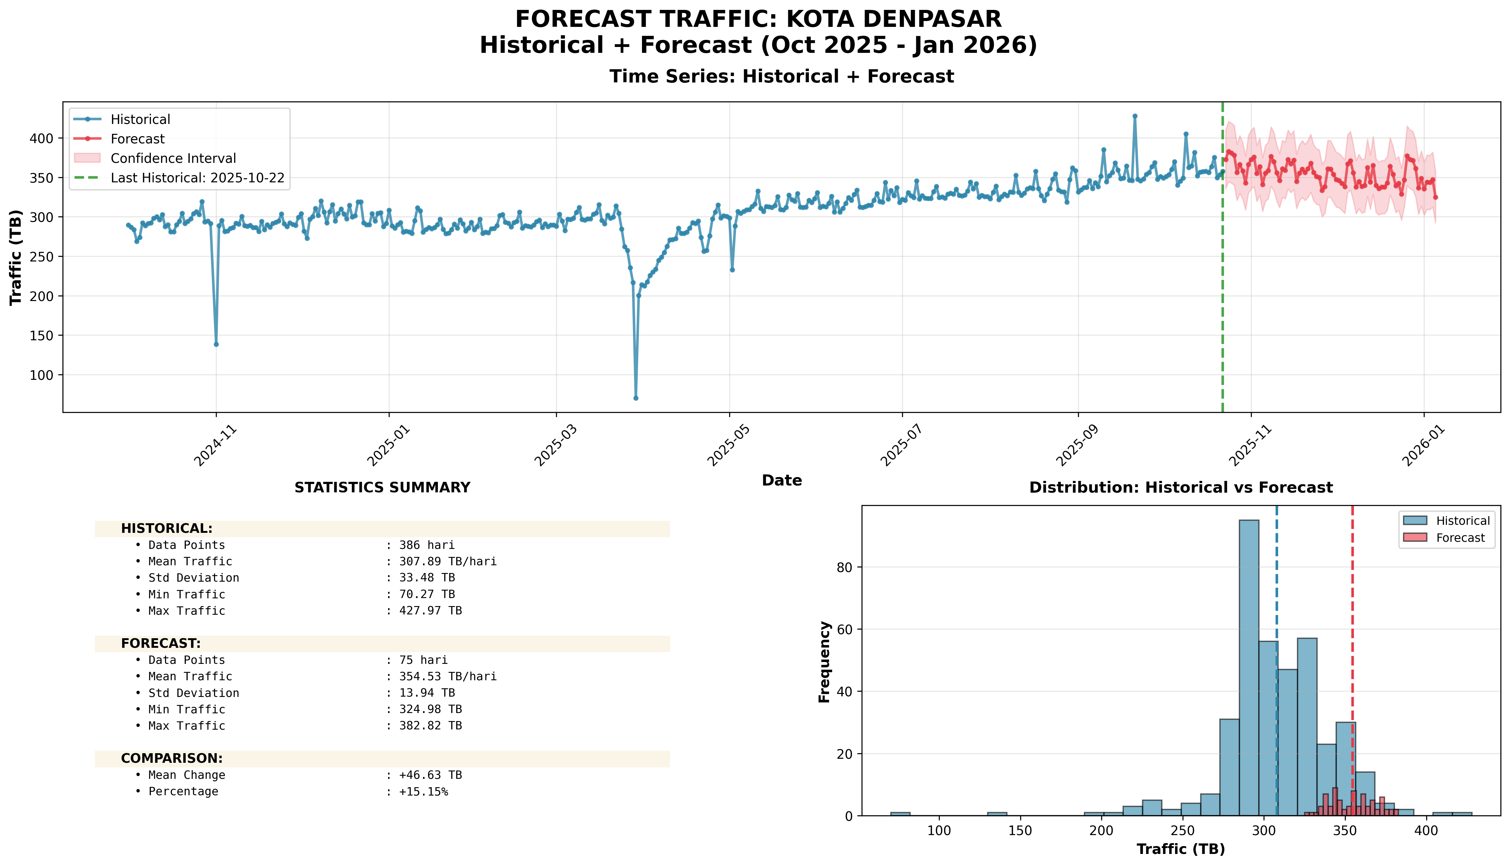
Top 10 Absolute: #4: KOTA DENPASAR (BALI NUSRA)

Slide 22
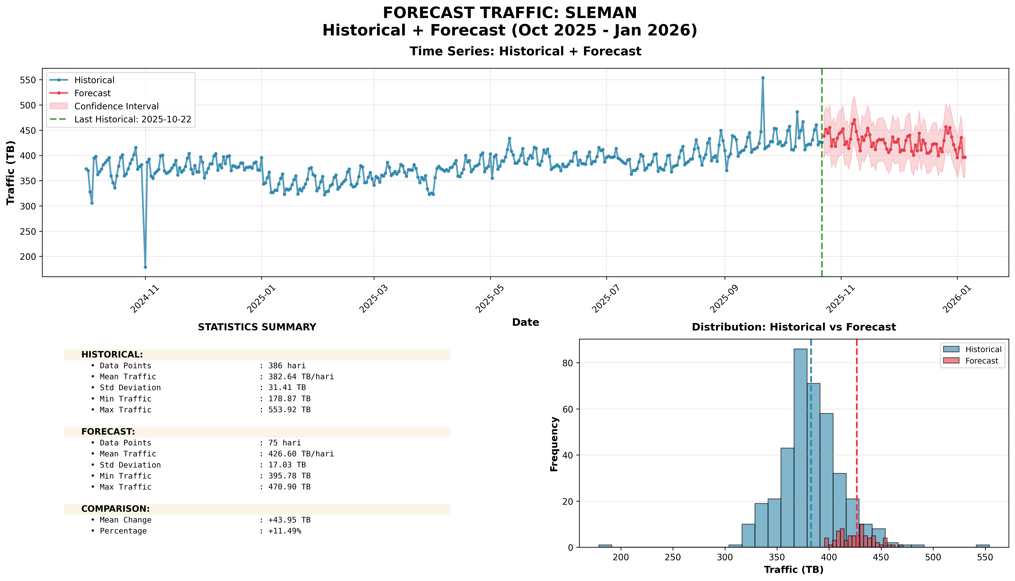
Top 10 Absolute: #5: SLEMAN (CENTRAL JAVA)

Slide 23
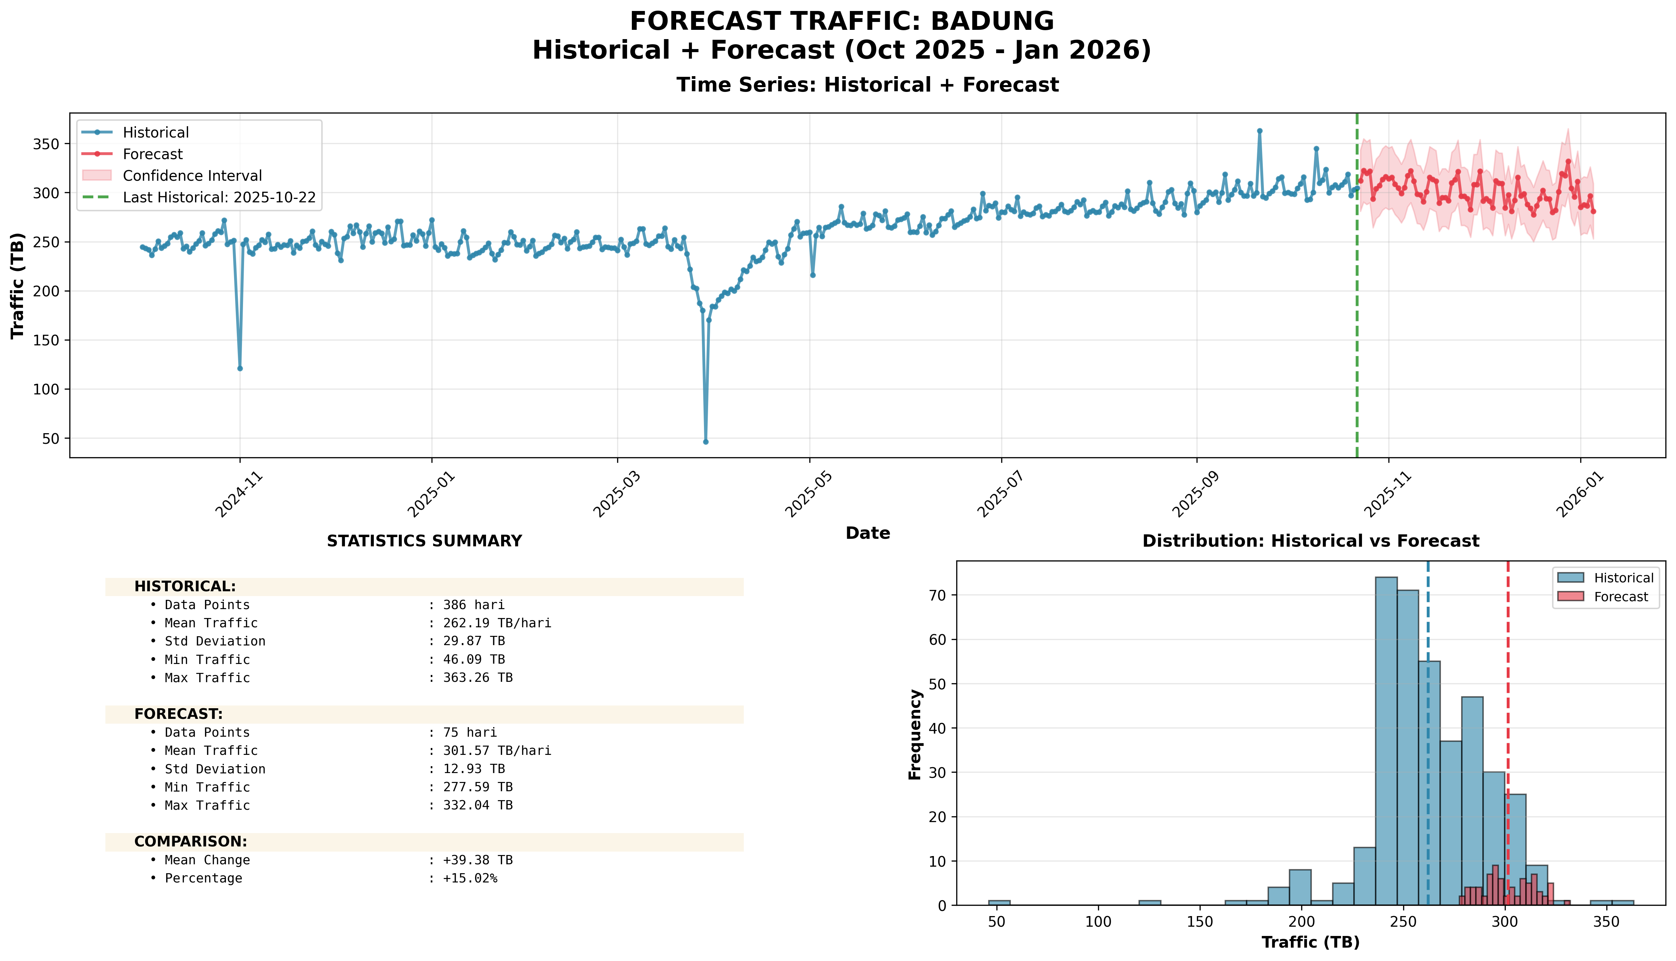
Top 10 Absolute: #6: BADUNG (BALI NUSRA)

Slide 24
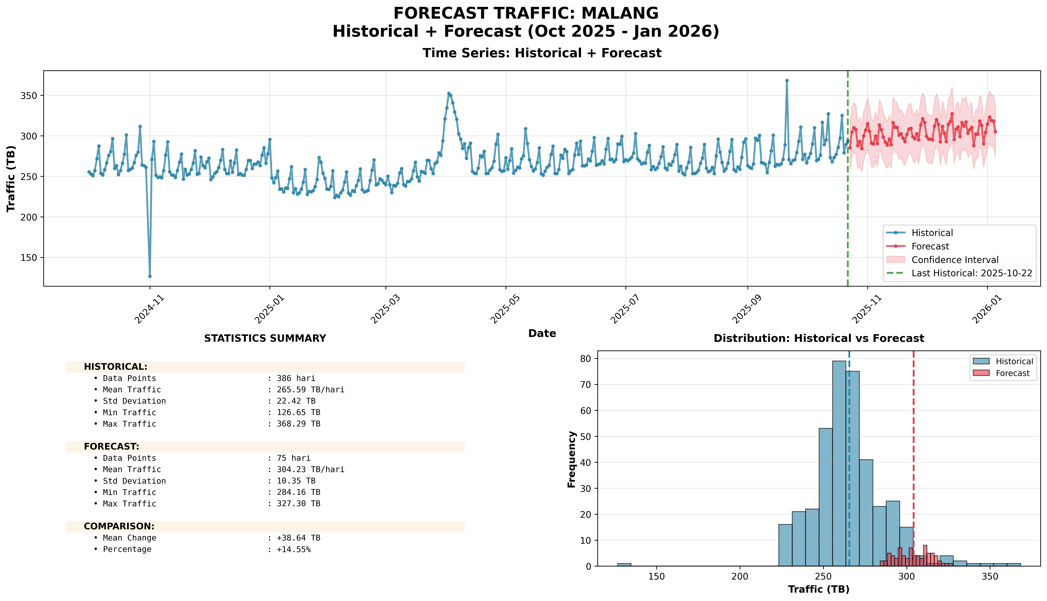
Top 10 Absolute: #7: MALANG (EAST JAVA)

Slide 25
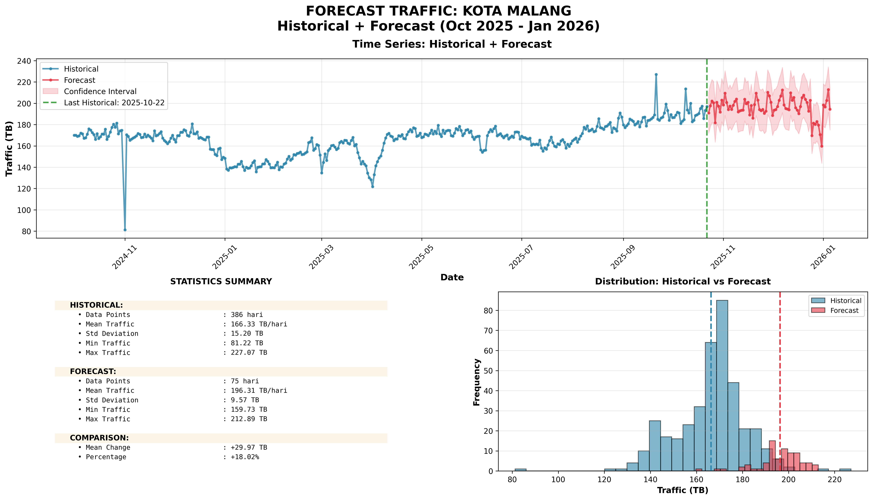
Top 10 Absolute: #8: KOTA MALANG (EAST JAVA)

Slide 26
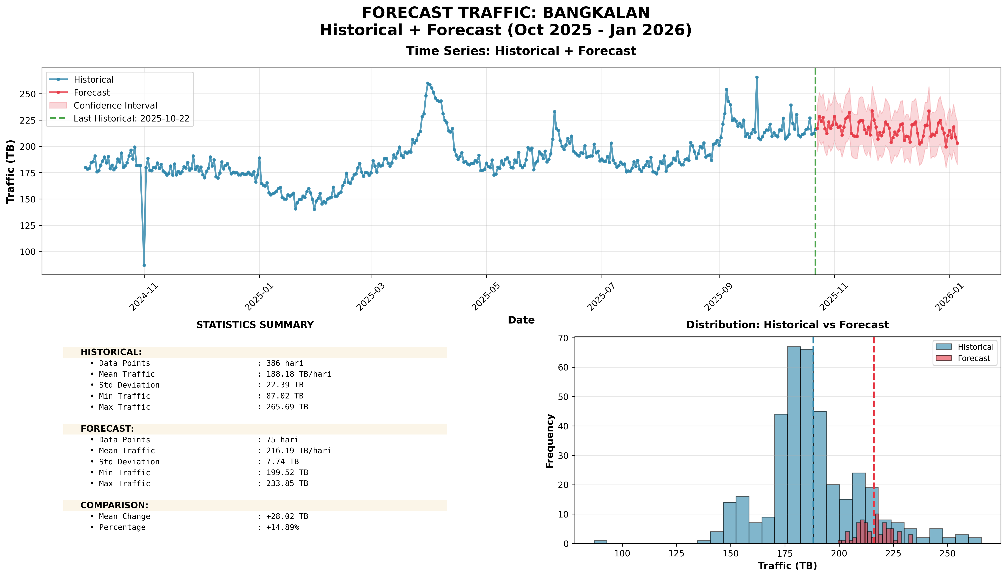
Top 10 Absolute: #9: BANGKALAN (EAST JAVA)

Slide 27
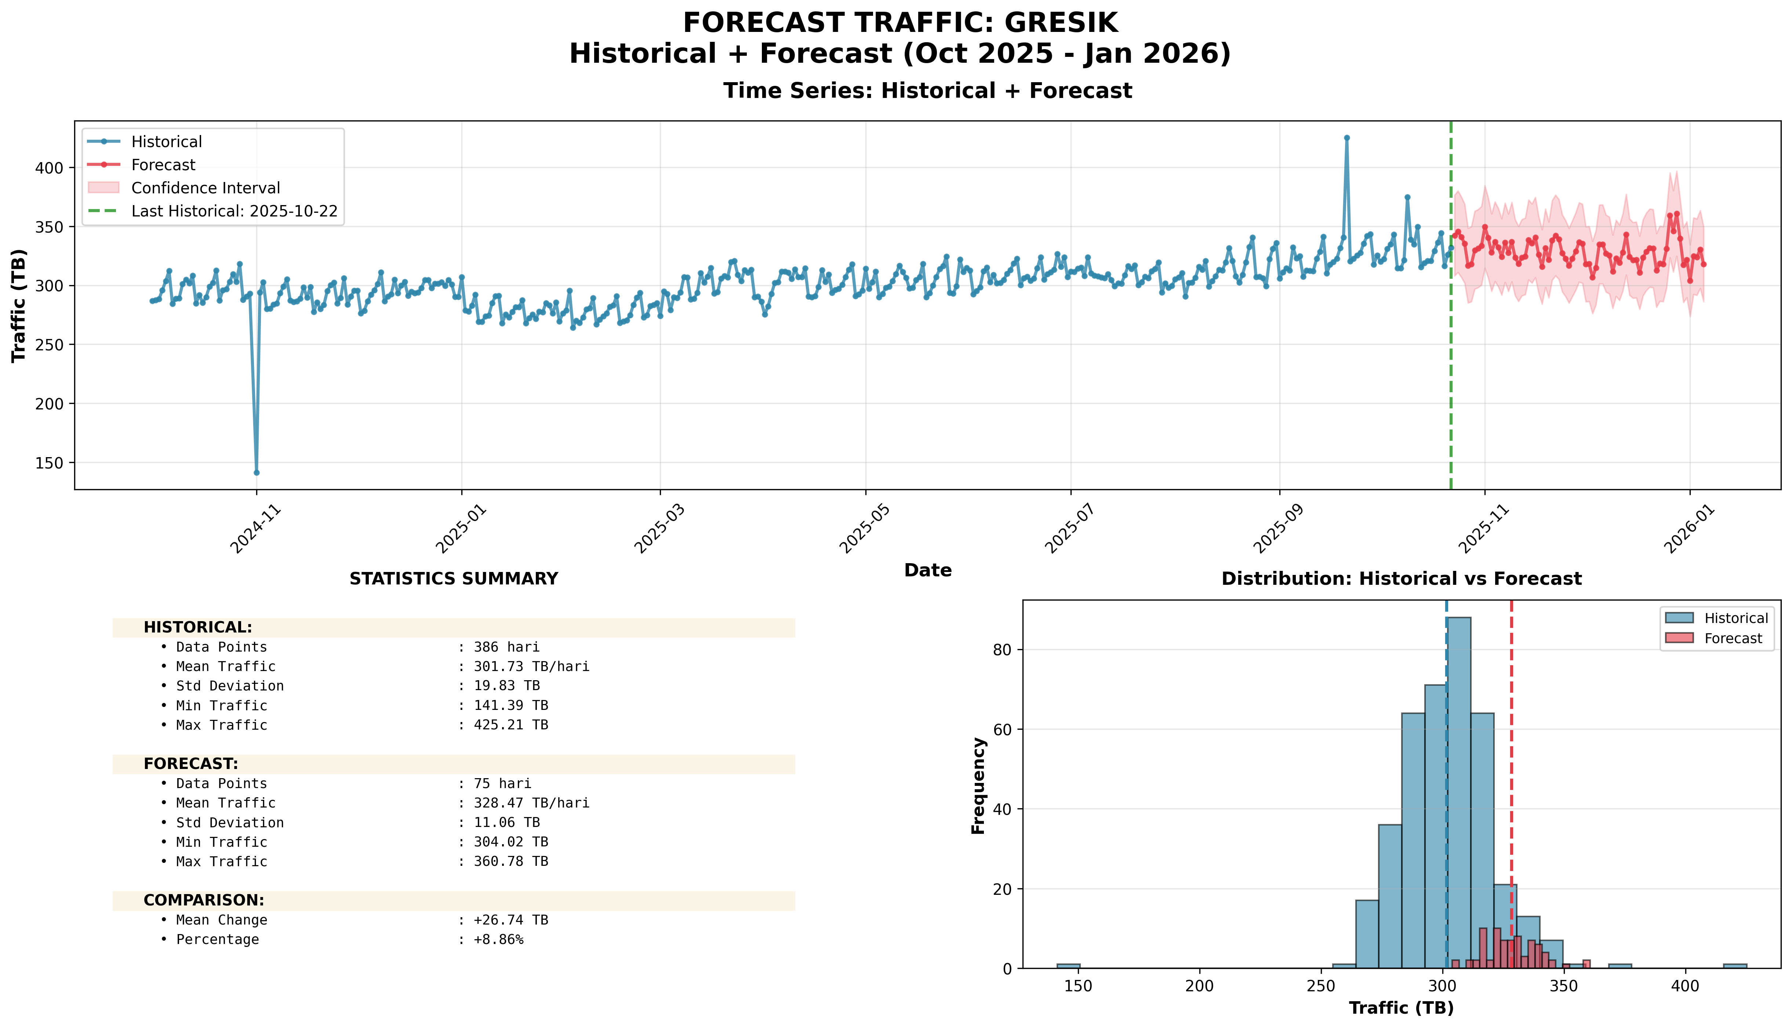
Top 10 Absolute: #10: GRESIK (EAST JAVA)

Slide 28
Github Project : https://github.com/daffasutrisno/Project-Forecast.git
Program: forecast_04_by_kabupaten.py → analysis_03_top10_percentage.py
Output:
forecast_results/05_analysis/top10_kabupaten_individual_forecast.png
forecast_results/04_kabupaten/[kabupaten]_forecast.png (10 kabupaten)

Slide 29
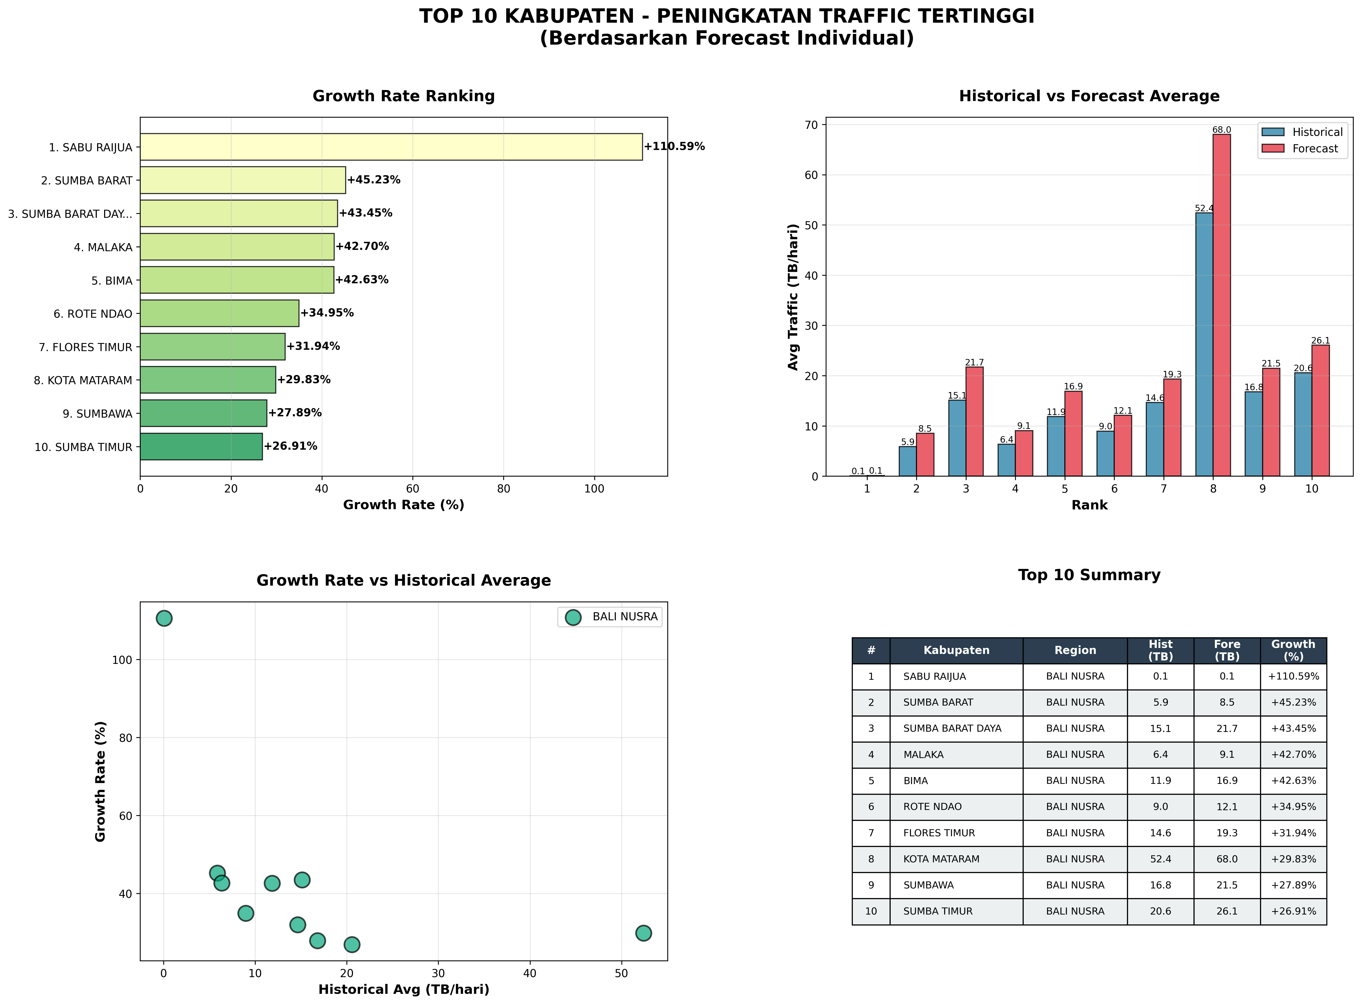
Top 10 Kabupaten: Growth Percentage (%)

Slide 30
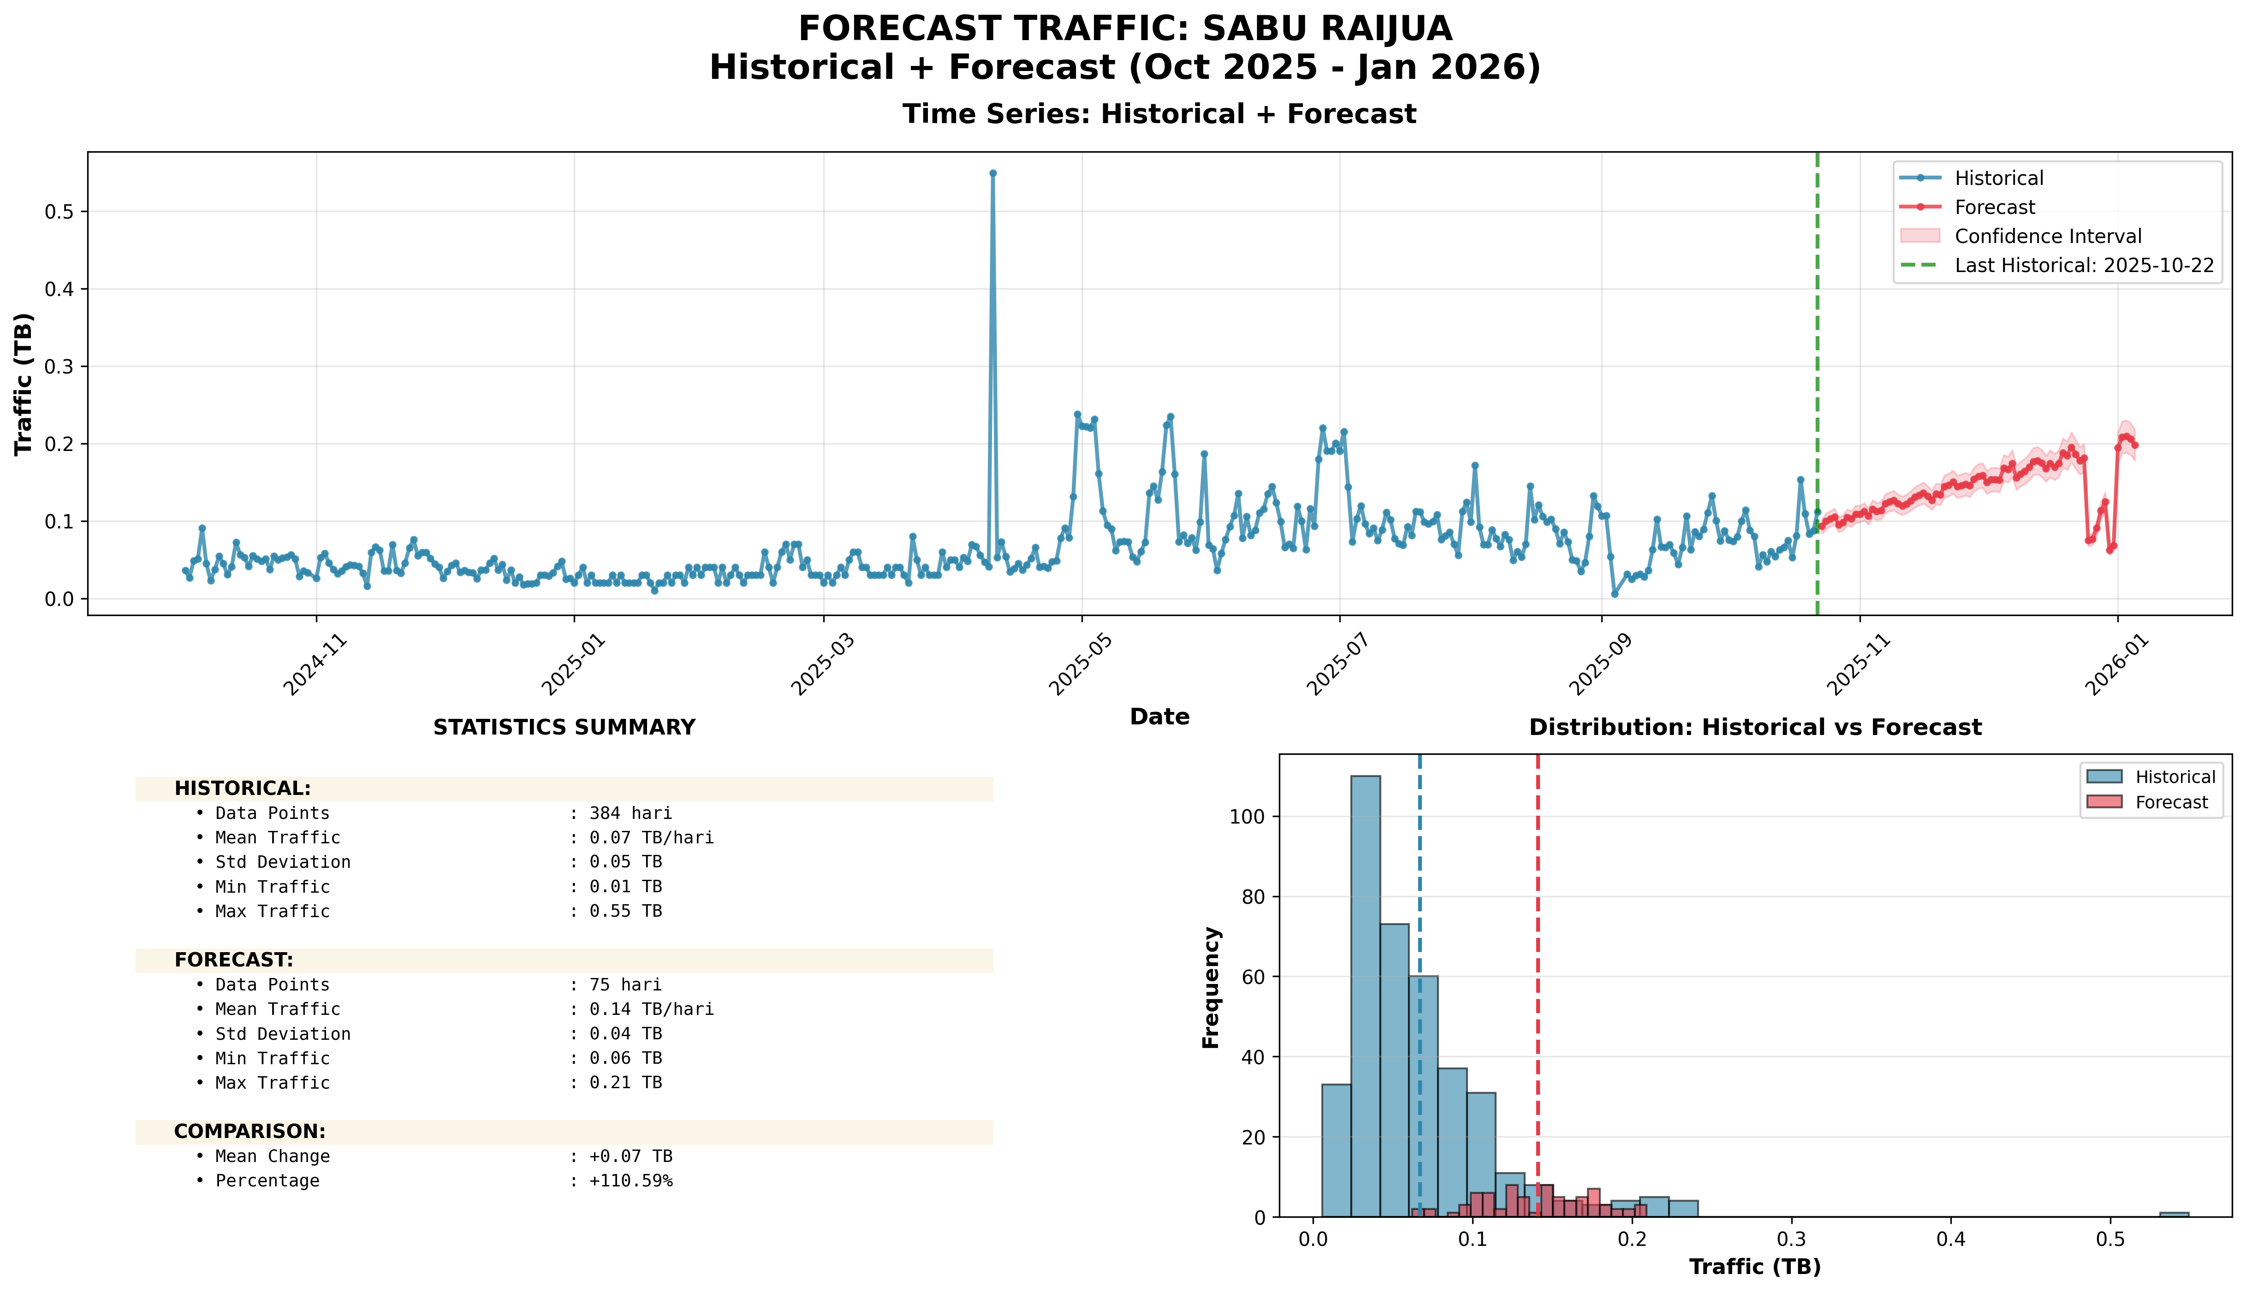
Top 10 Percentage: #1: SABU RAIJUA (+110.59%)

Slide 31
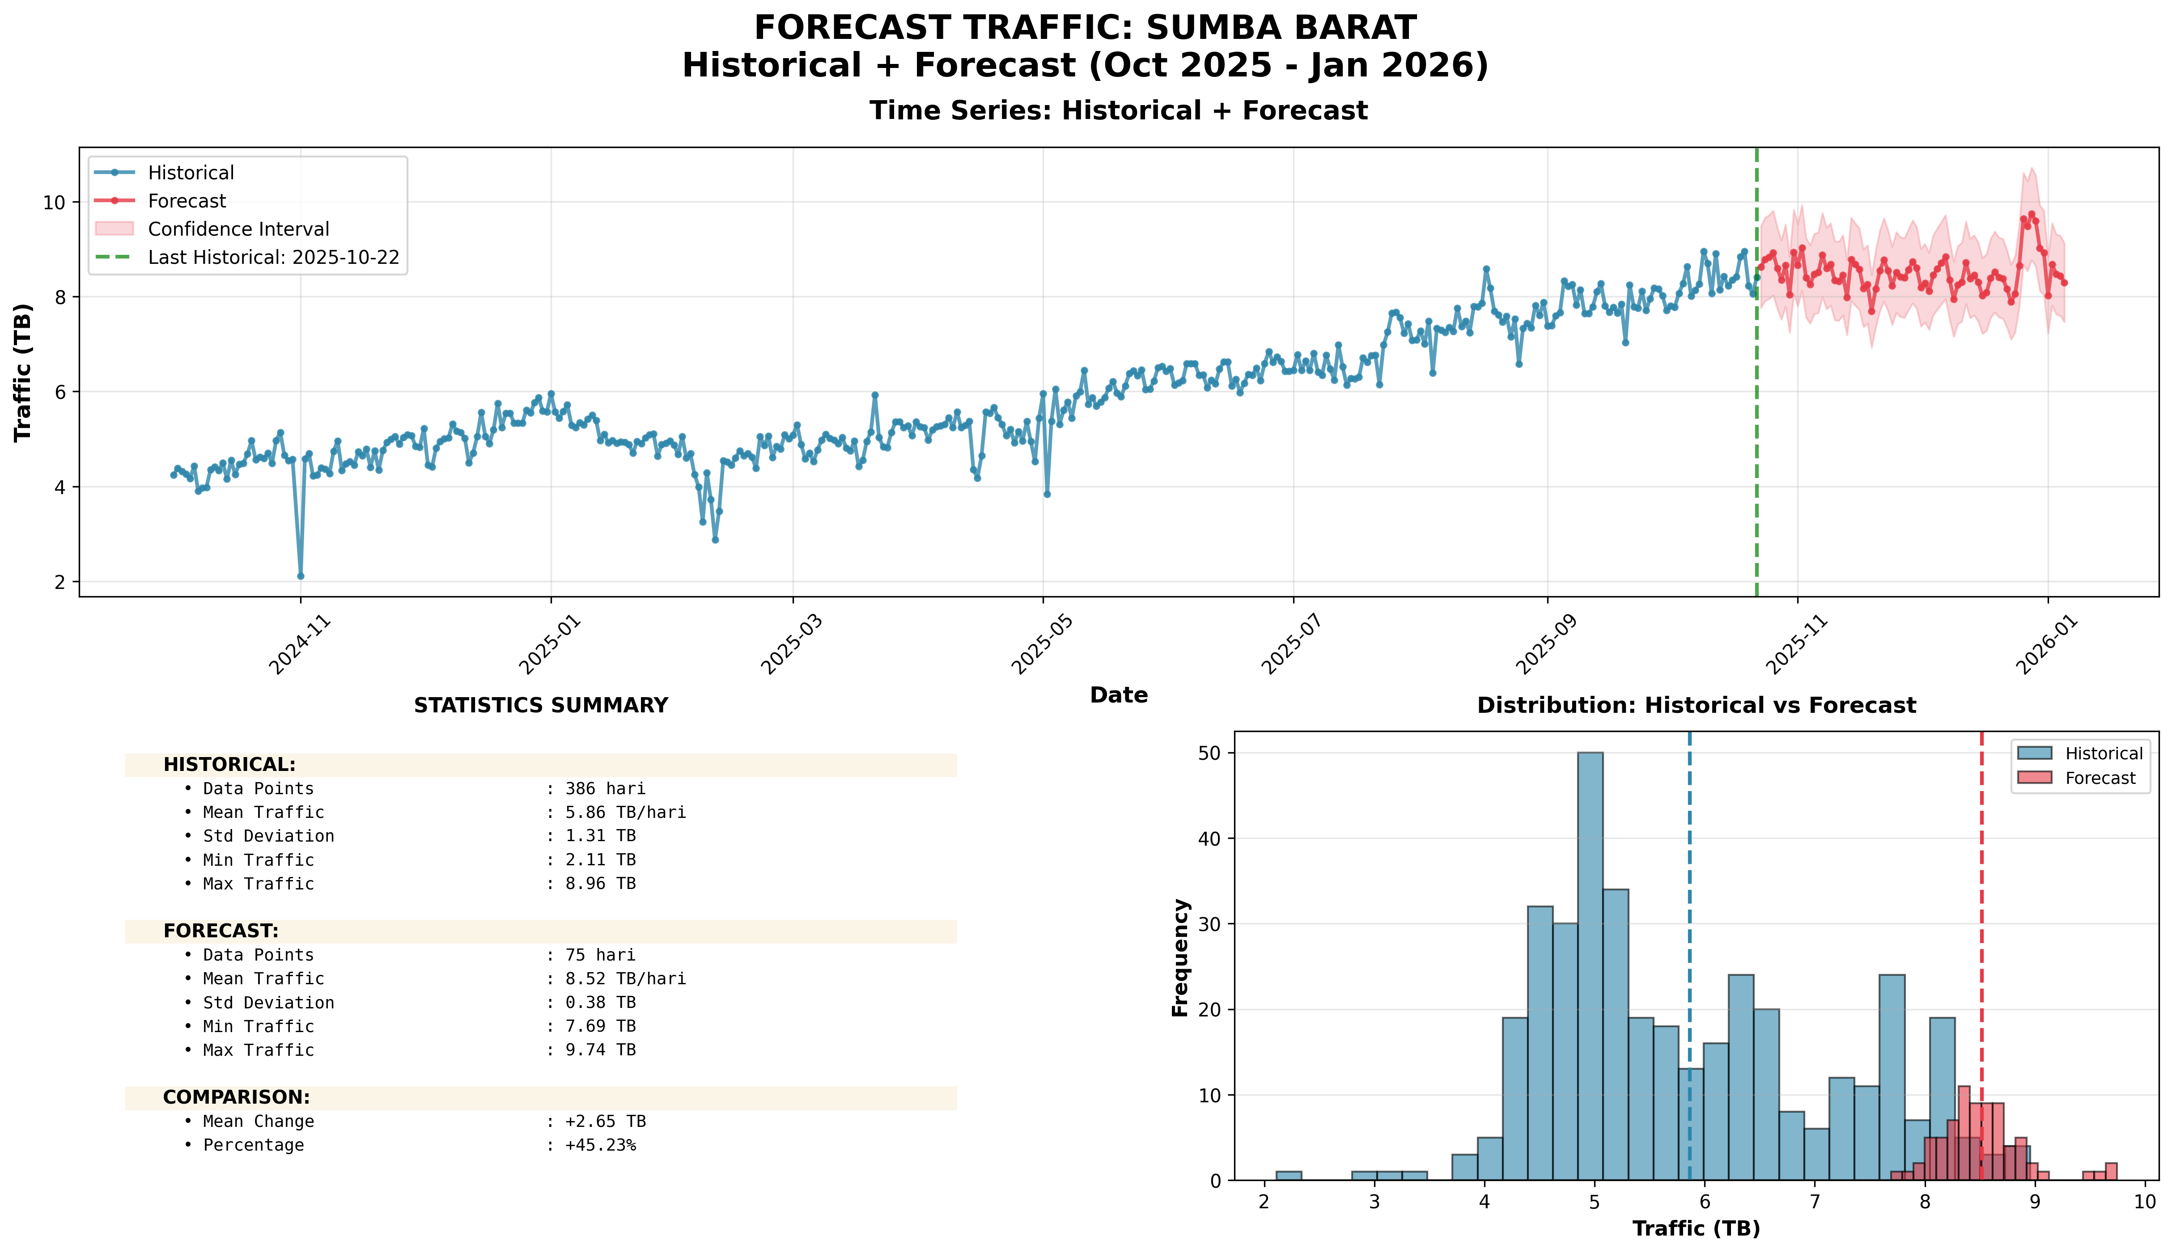
Top 10 Percentage: #2: SUMBA BARAT (+45.23%)

Slide 32
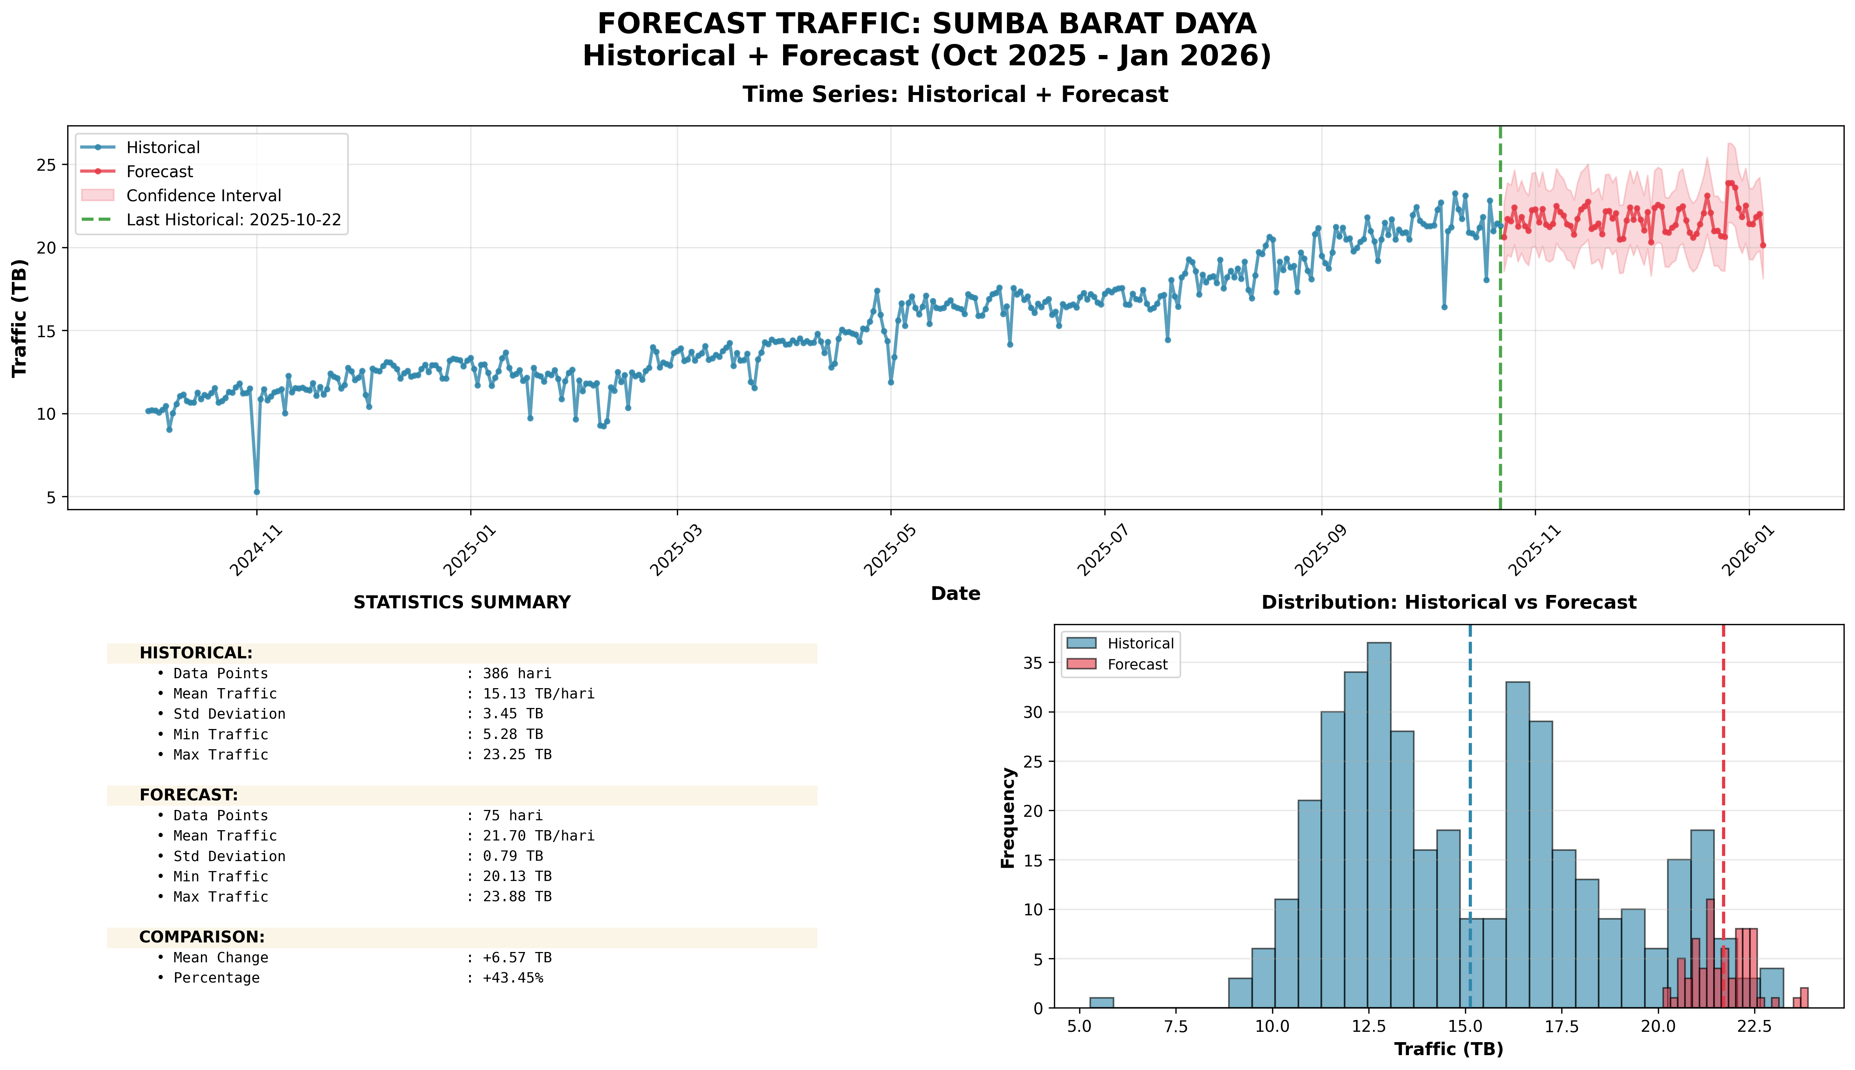
Top 10 Percentage: #3: SUMBA BARAT DAYA (+43.45%)

Slide 33
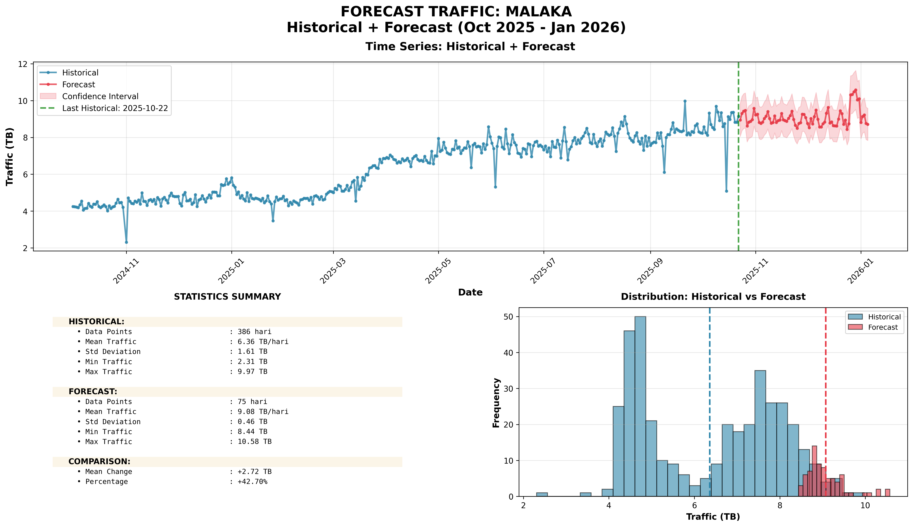
Top 10 Percentage: #4: MALAKA (+42.70%)

Slide 34
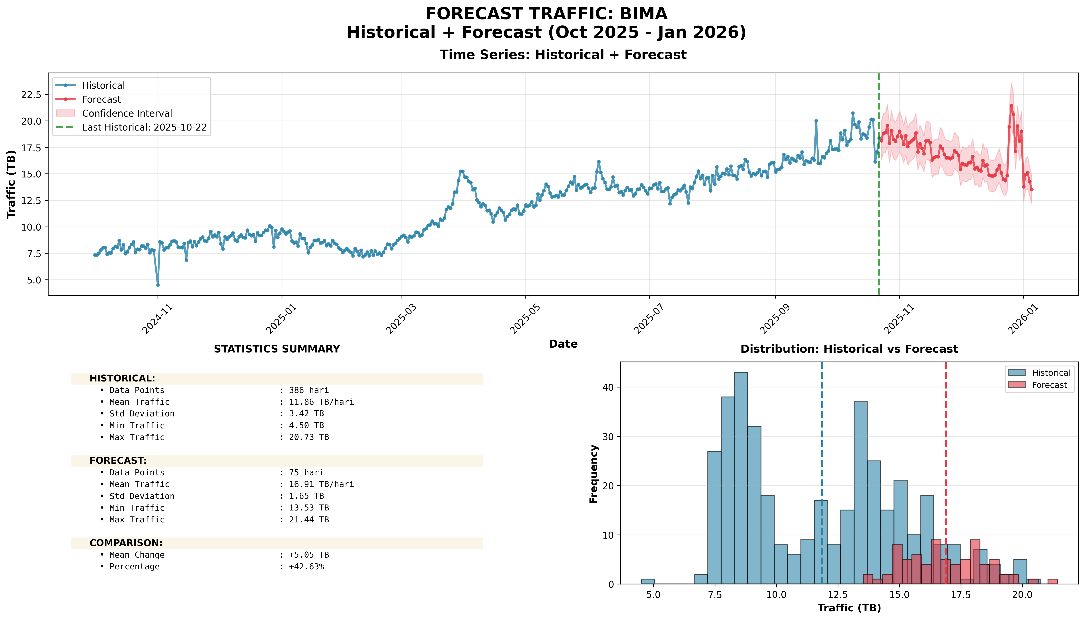
Top 10 Percentage: #5: BIMA (+42.63%)

Slide 35
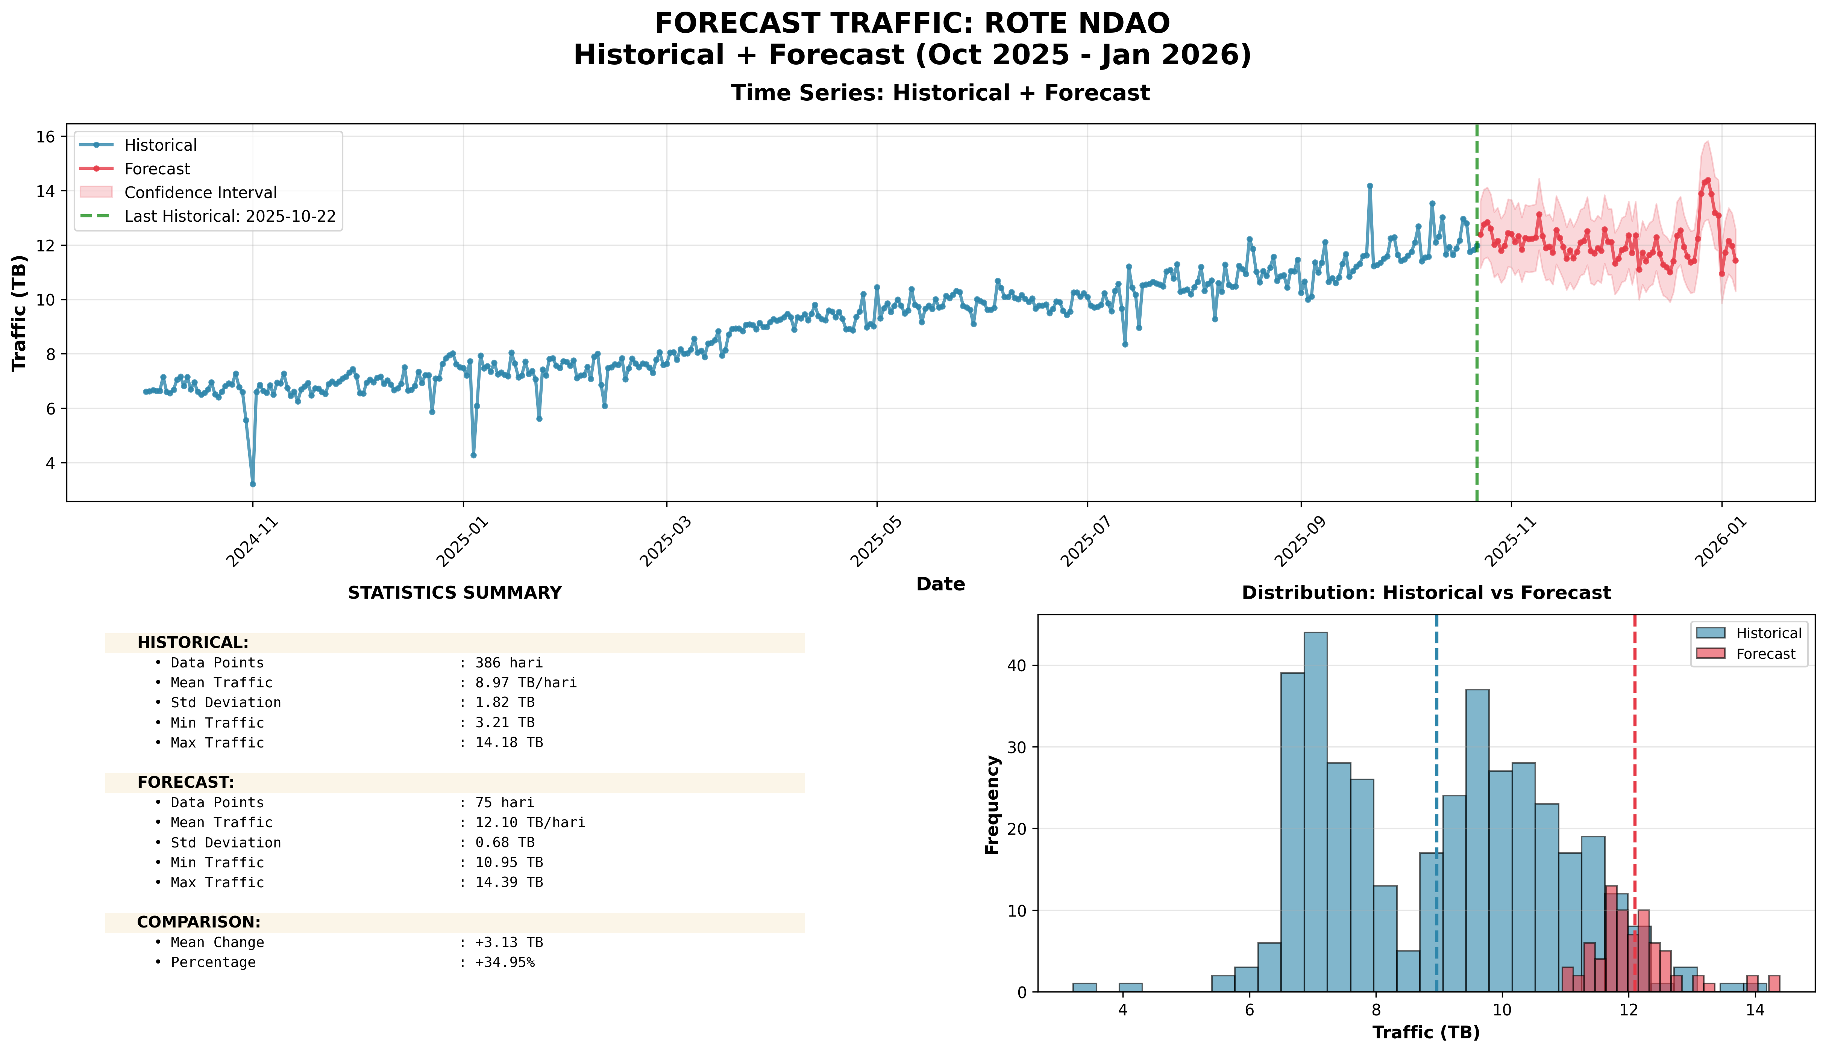
Top 10 Percentage: #6: ROTE NDAO (+34.95%)

Slide 36
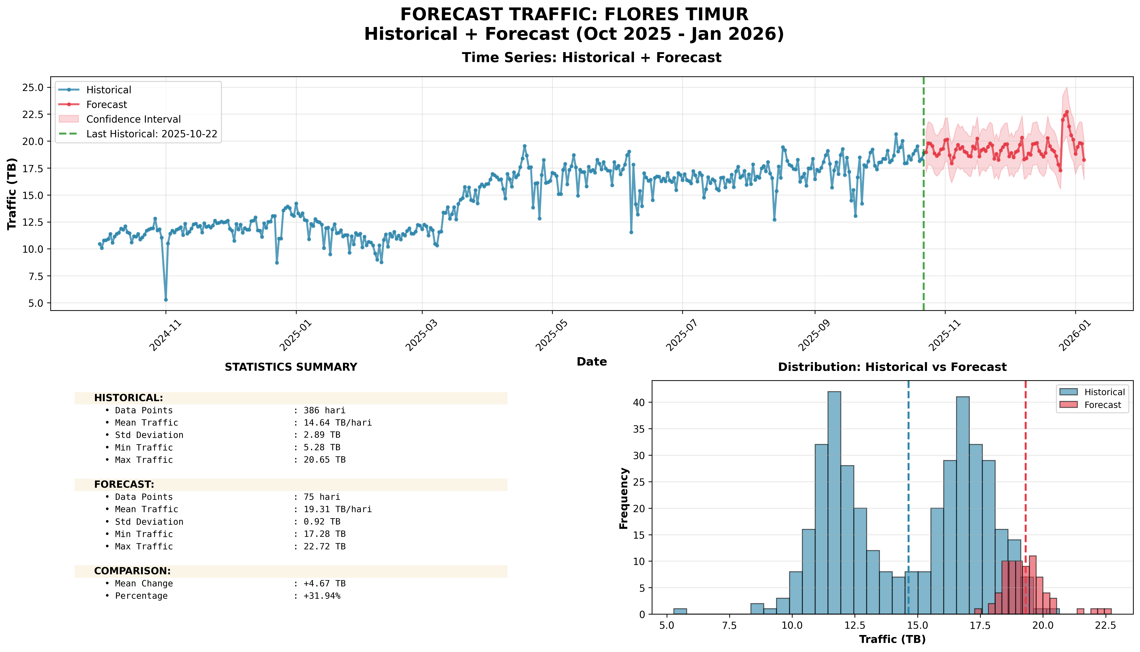
Top 10 Percentage: #7: FLORES TIMUR (+31.94%)

Slide 37
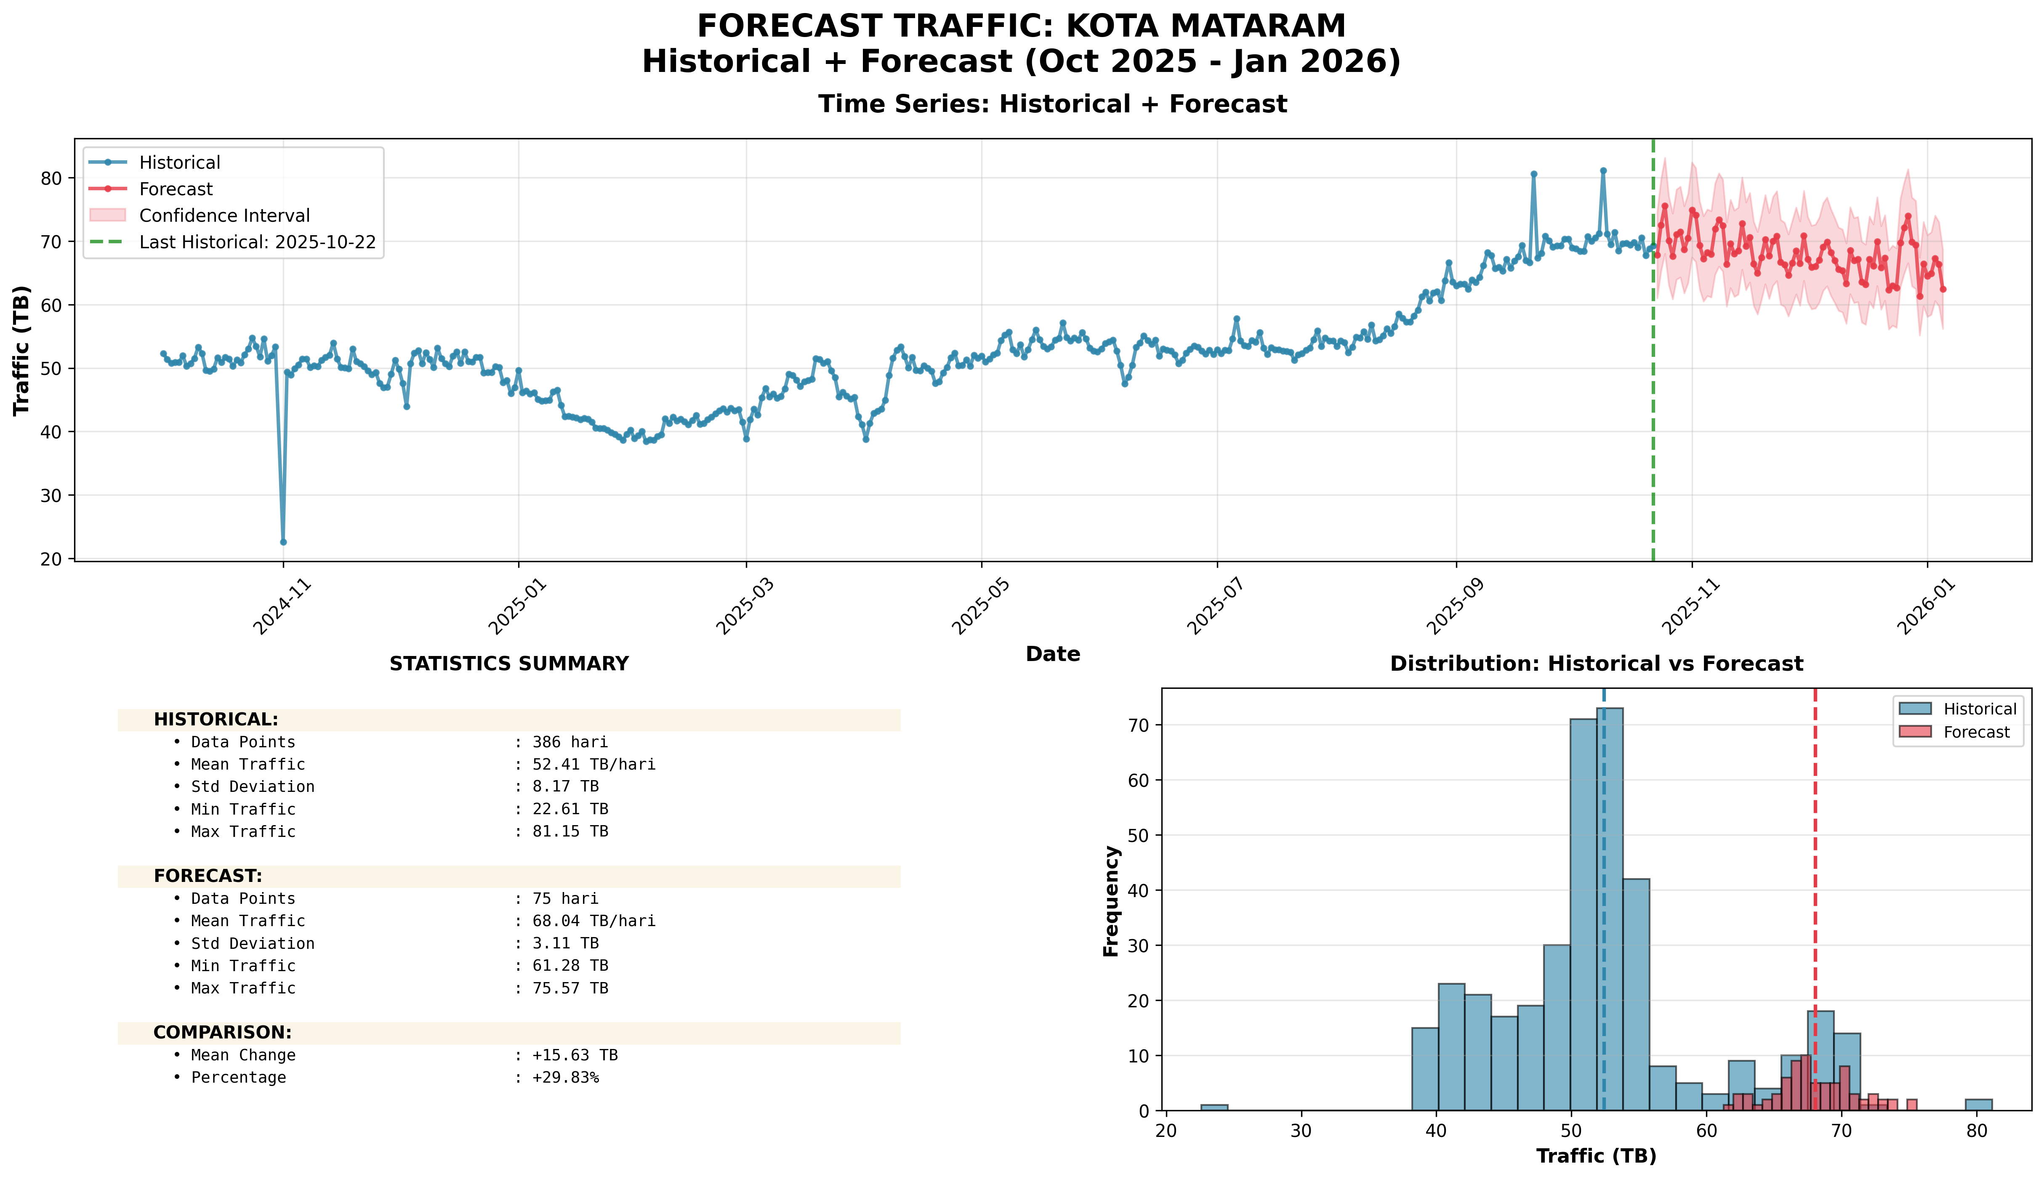
Top 10 Percentage: #8: KOTA MATARAM (+29.83%)

Slide 38
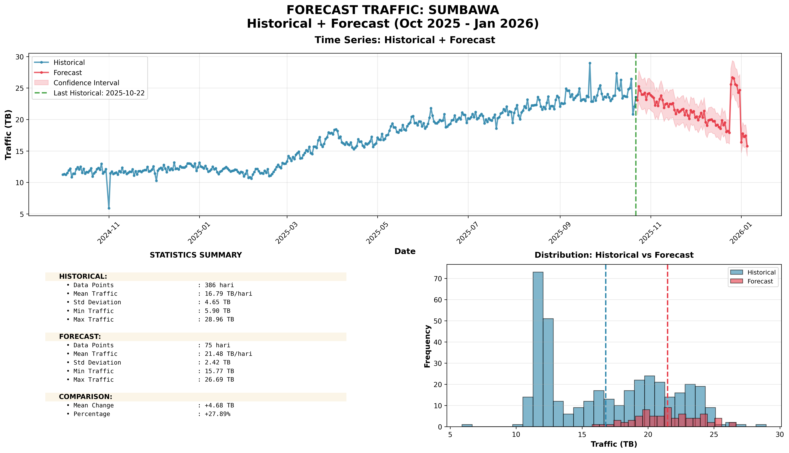
Top 10 Percentage: #9: SUMBAWA (+27.89%)

Slide 39
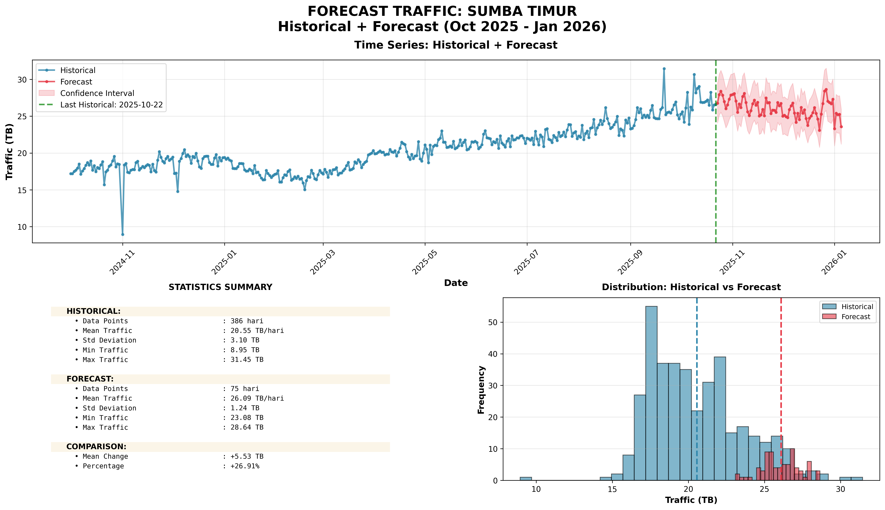
Top 10 Percentage: #10: SUMBA TIMUR (+26.91%)

